Slide 1

MUST FARM
BRITAIN IN THE BRONZE AGE

Slide 2


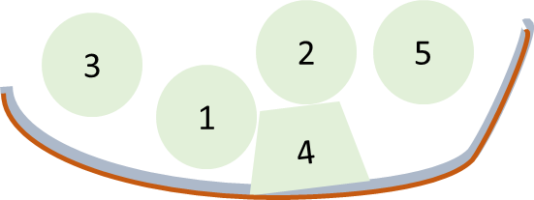


ABOUT MUST FARM
Archaeologists found 5 structures. Four were round and one was square. The structures were surrounded by a wooden walkway and a fence
Must Farm was a Bronze Age site near Peterborough.
Dry land
It was built above a river. The buildings were on stilts to lift them above the water
Structures
Walkway and fence
Notes:
Must Farm was a late Bronze Age site 1000-800BC. 5 wooden structures, a walkway and fence were found. It was just outside modern day Whittlesey
There were probably more structures over the dry land that did not survive as they were not preserved, they dried out and rotted away
Why do you think they built it above a river?

Slide 3
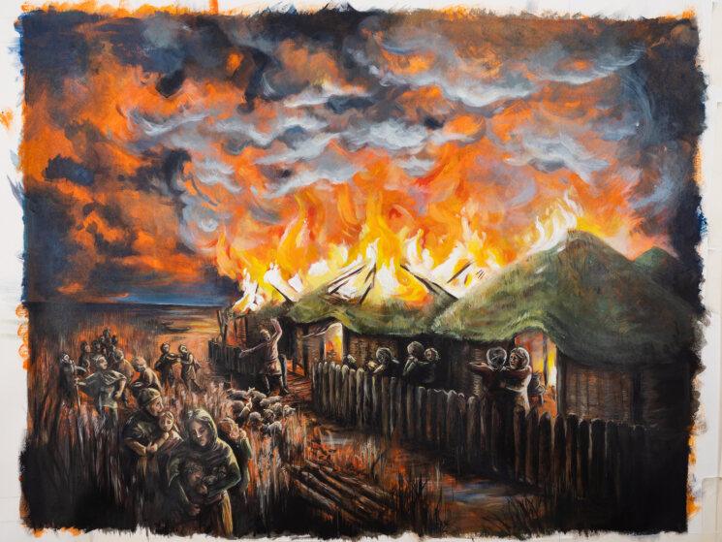
ABOUT MUST FARM
Must Farm was destroyed in a fire. People lived there for less than a year
It was abandoned very quickly, and a lot was left behind. This left lots of objects for archaeologists to ﬁnd.
Painting: Natalie Bates​
Notes:
Archaeologists can find out a lot of information from Must Farm because it was left exactly how the people that lived there would have used it. This doesn’t usually happen in archaeology. The water and charring from the fire led to high levels of preservation, so we find materials like wood and fibres that would not usually survive
The people left in a hurry because of the fire and left lots and lots behind.

Slide 4
HOW IT WAS FOUND AND WHY DID IT SURVIVE ?
Must Farm was first discovered in 1999, in a quarry. Archaeologists started excavating (digging) in 2015-6
During the ﬁre the structures and everything in them dropped straight into the river.
The river was slow and shallow, and there were lots of plants. This stopped everything washing away.
The water and mud in the river preserved the objects. This means archaeologists found artefacts that do not usually survive, especially objects made from wood.
There is nothing left at Must Farm now. It has all been dug up.
Notes:
Some timbers were discovered sticking out of the side of the quarry. This was the beginning of Must Farm.
Small excavations happened before the site was fully excavated
The houses and everything in them dropped into the mud at the bottom of the river channel. The river current was not strong enough to wash them away. Plants growing there kept them in place. This means archaeologists found the site and artefacts exactly as they were left.
Muddy, wet conditions preserve objects that would usually dry out and rot away over time. This is why so many things survived at Must Farm that wouldn’t normally, and what archaeologists found so much wood at Must Farm.
The site was completely excavated and all the objects taken away to be preserved. Lots of photographs, drawings and maps were made of the site so that we know exactly what it looked like before it was dug up. As Must Farm was found in a working quarry, it has now been dug away for gravel extraction.

Slide 5
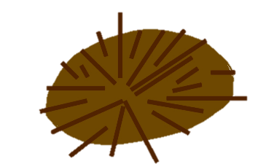
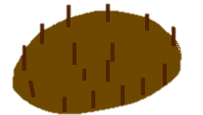
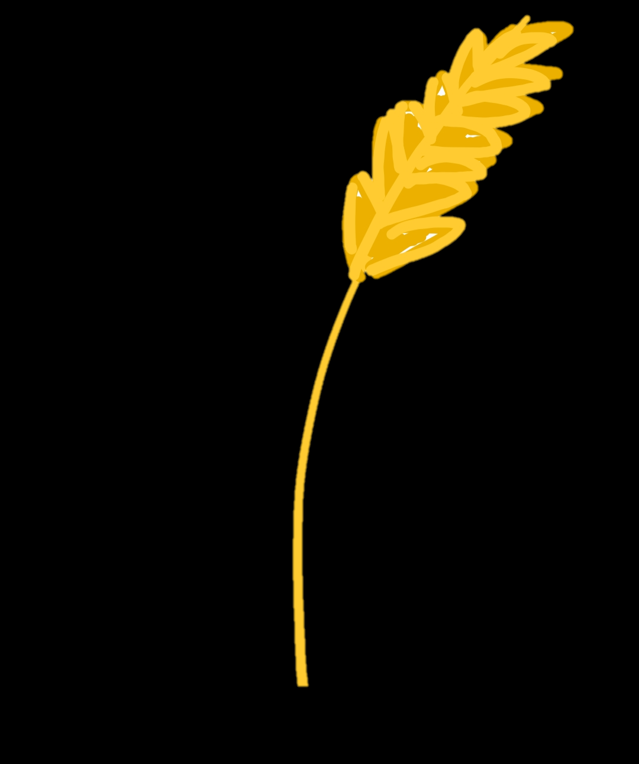
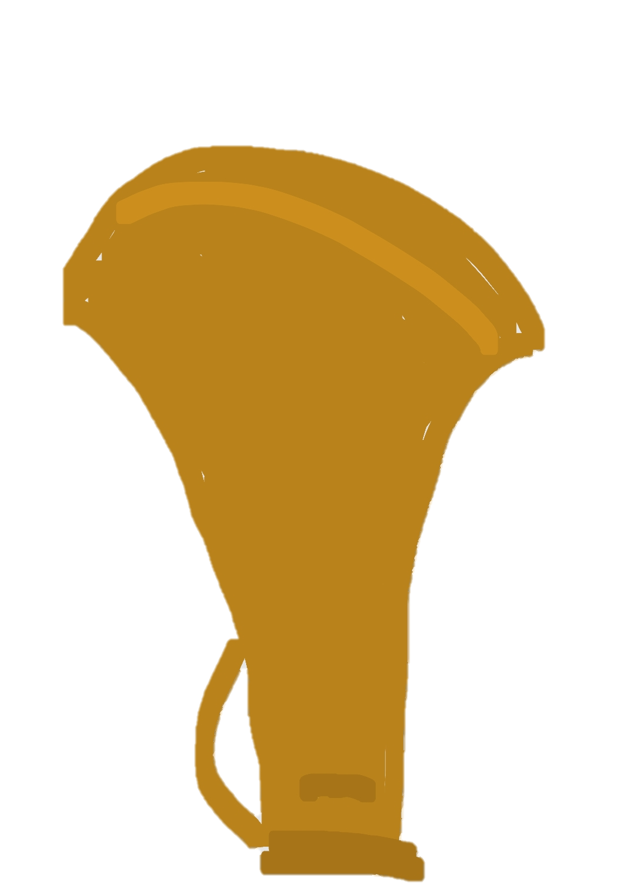
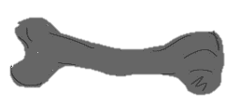
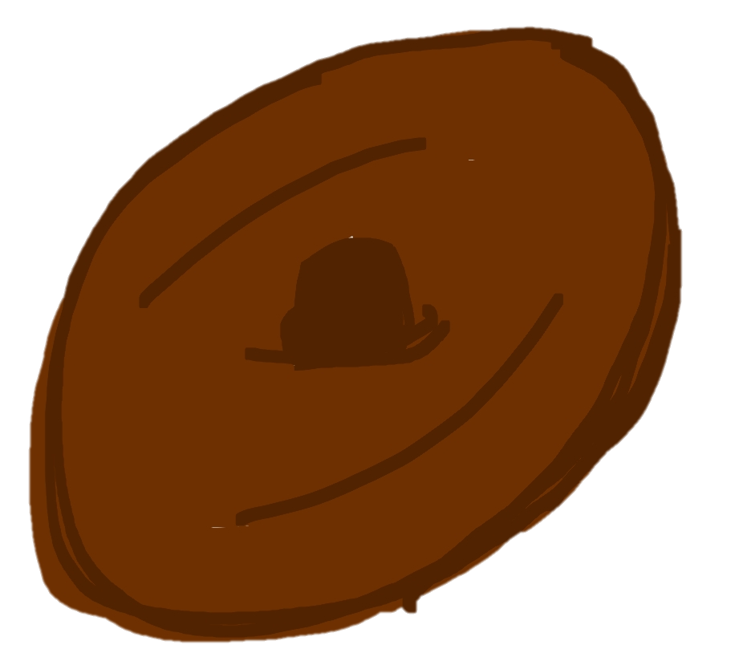
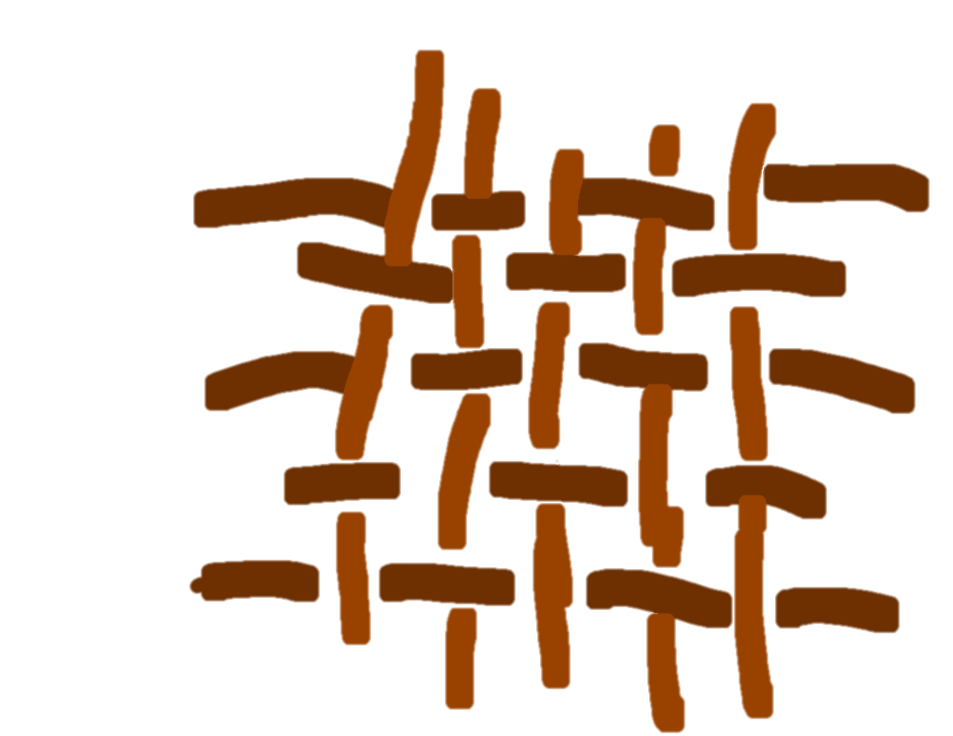

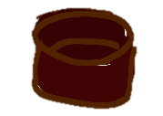
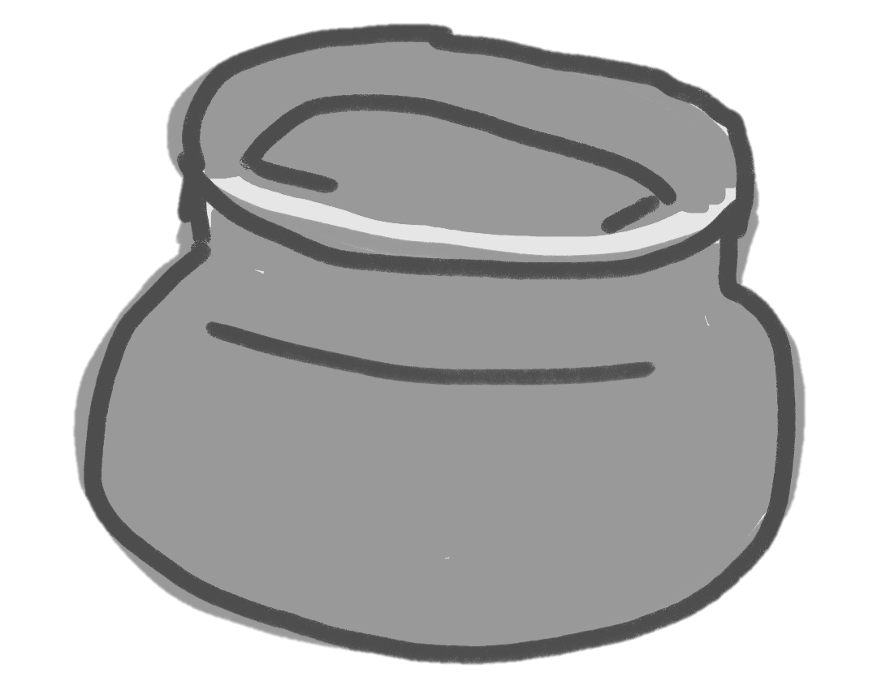
Archaeologists found the remains of:
ARCHAEOLOGY- artefacts
The wood from the buildings,
walkway and fence
The stilts the buildings stood on
Plants like wheat
Tools like axes, hammers and knives
A wooden wheel
Animal bones
Fabric, threads and the plants used to make the threads
Buckets
Beads
Pottery
Notes:
Archaeologists found a lot of artefacts. They tell us a lot about Bronze Age life.
Usually if sites are abandoned because people are moving on they take everything with them! Or archaeologists would usually find things that were thrown away in rubbish pits or lost. Because people left Must Farm and left everything behind we can see many more objects that people would have been using in their everyday lives
This gives us a much better understanding of life in the bronze age, the tools people used, the food they ates, the types of objects they had and how they made their roundhouses

Slide 6
ARCHAEOLOGY- what does it tell us?
Wooden remains of houses
The materials they used to build with. How buildings were constructed.
Animal bones
What people hunted and where they found their food.
Fabric, threads and plant fibre
What they made cloth from, and how it got from a plant to material
Tools like axes, hammers and knives
The equipment they had to make things from. The materials they had to make this equipment. How they used their equipment
Beads
People liked to decorate themselves. They had arts and crafts. They traded with different places to get glass and gems.
Plant remains like grains
What people ate, and what they were growing
Pottery
What they stored things in. The type of cooking pots they had. The shape and size of different pots.
Notes:
What do you think this evidence tells us about the Bronze Age?
Remains of houses-archaeologists can tell the type of wood they used to build, a mixture of ash and oak. 6000 pieces of wood were found from tiny woodchips to huge timber posts. The wood is so well preserved we can see the remains of bark and tool marks. Archaeologists can piece together the construction methods too from the position of the timbers and remains of joints
Animal Bones- sheep, calf, pig, wild boar and red deer were all found. Most of the animal bone found was of wild animals, suggesting they were going onto the dry land to hunt for food. Very little fish was found. The sheep and calf remains were found inside the roundhouses, suggesting they were kept inside
Fabric, threads and fibre-evidence has been found of the whole process of cloth making. From natural plant fibres like flax to thread, even thread on bobbins and then the finished cloth. This helps us understand how people were making thread and making cloth in the Bronze Age
Tools- all kinds of tools have been found at Must Farm. These include things used in the home and for farming and construction. Things like axes, sickles, hammers, razors, knives, shafts and handles of artefacts, buckets, troughs and more. There were even two wheels found on site. This helps us understand the items people used in their daily lives. The variety of artefacts gives an idea of everything people needed for life in the Bronze Age
Beads- glass beads were found at Must Farm, alongside beads made from amber and jet. They were not made locally so this gives us evidence that there a trade happening between bronze age Britain and places further afield. The beads could have come from places like Turkey or Syria. It also tells us that people liked to decorate themselves.
Plant remains- grains were found still in pots, as was porridge. There was even a bowl with a spoon and food remains. It tells us about the kind of cereals people were growing the Bronze Age. Barley, emmer wheat (an ancient grain) and flax were found.
Pottery- a huge amount of pottery was found. Tiny vessels as well as huge storage jars were excavated. A number of complete vessels were found. The style of a lot of the vessels are the same, suggesting they were made by one person. Some of the pots are coarse- thick, uneven, undecorated and used for everyday storage and cooking pots and some are fine-thin, with even walls and decorated.

Slide 7




ARCHAEOLOGY- what does it tell us?
Archaeologists found a lot of the same objects in the same places in each building
The objects didn’t float away after they fell in the water, they stayed where they were
This tells us about the layout of Bronze Age homes and where people were doing different activities
Mostly empty: Possibly the sleeping area
Pots
Metal tools
Animal Bones: storing meat/ cooking
Fibres for fabric making
Way in
Notes:
Throughout all the structures there is a general pattern of what artefacts are found where.
When they fell in the river, things stayed largely where they were kept inside the roundhouses.
The area for pots and metal tools was probably for cooking and storage. The area of animal bones was probably where lambs were kept, or joints of meat that were being preserved or prepared for cooking.
As the area on the top left was mostly empty compared to the rest of the roundhouse, archaeologists think it was used for sleeping in.
The entrance was probably at the very bottom middle of this diagram, between the fibres and animal bones. There were not clear entrances to all the structures but fabric making is often found near the entrance.
There would have been a hearth with a fire in each house, and some kind of hole in the roof, possibly with a clay chimney to let smoke out

Slide 8
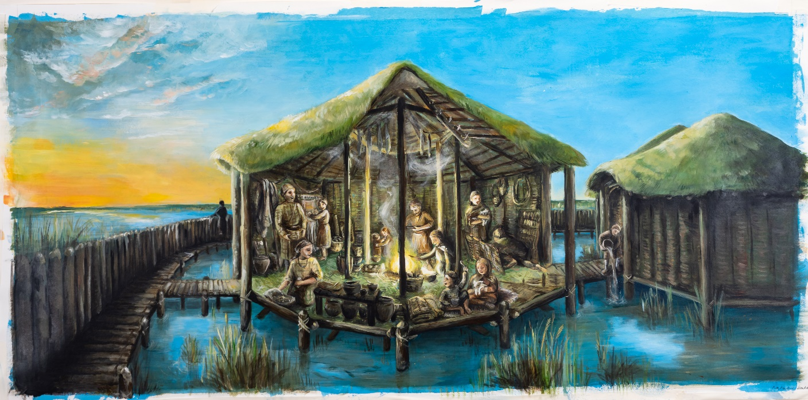
Painting: Natalie Bates
Notes:
This is our artist's impression of the houses at Must Farm
What can you see?
What would be happening?
What can you guess?
What else do you want to know?

