Slide 1
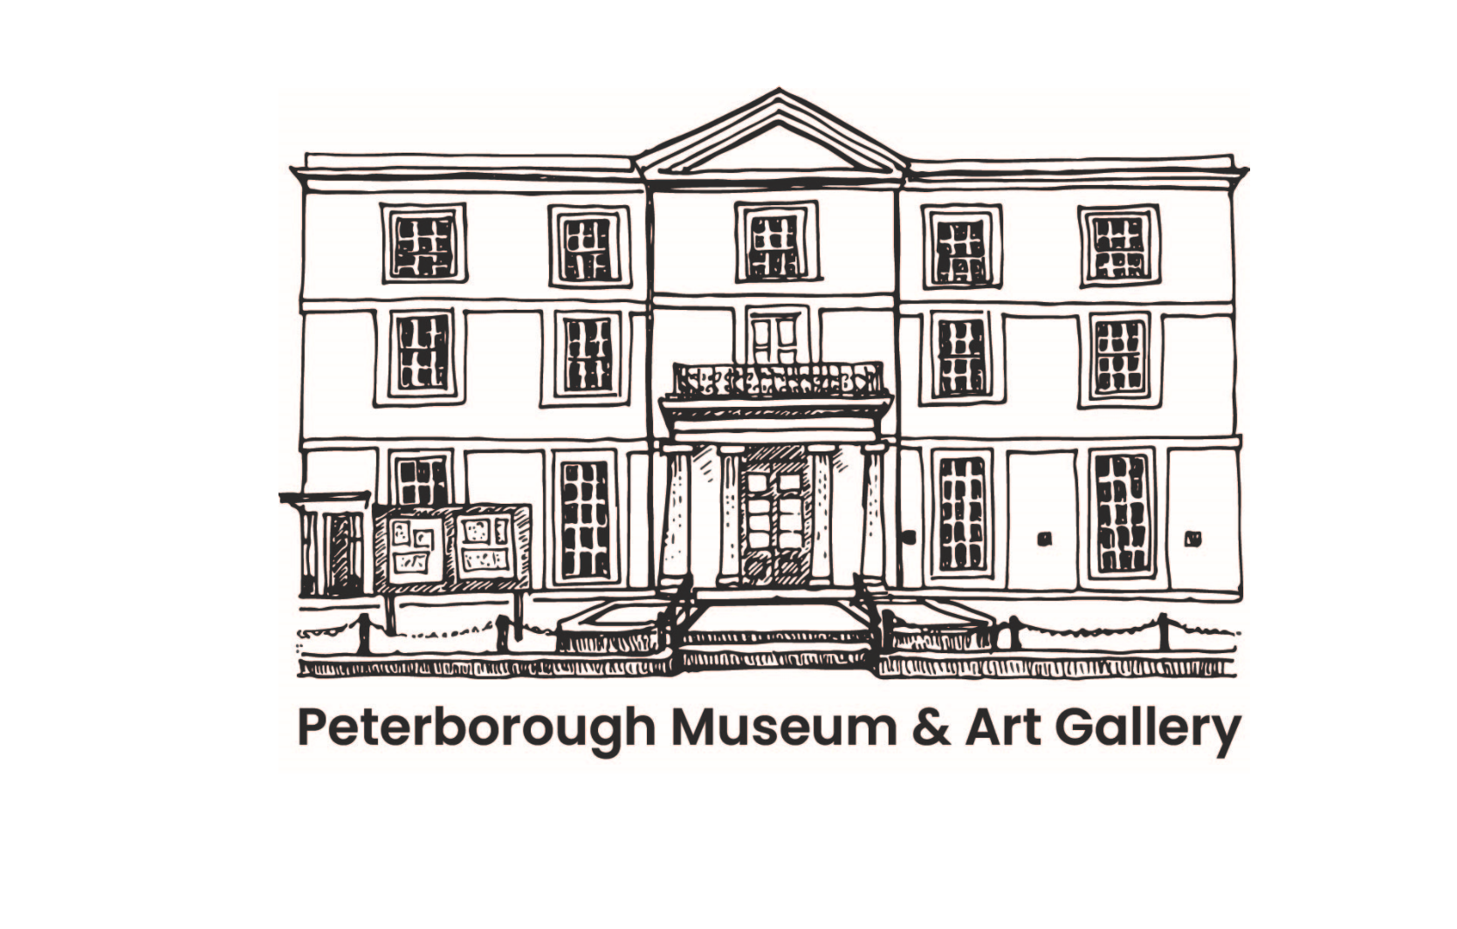
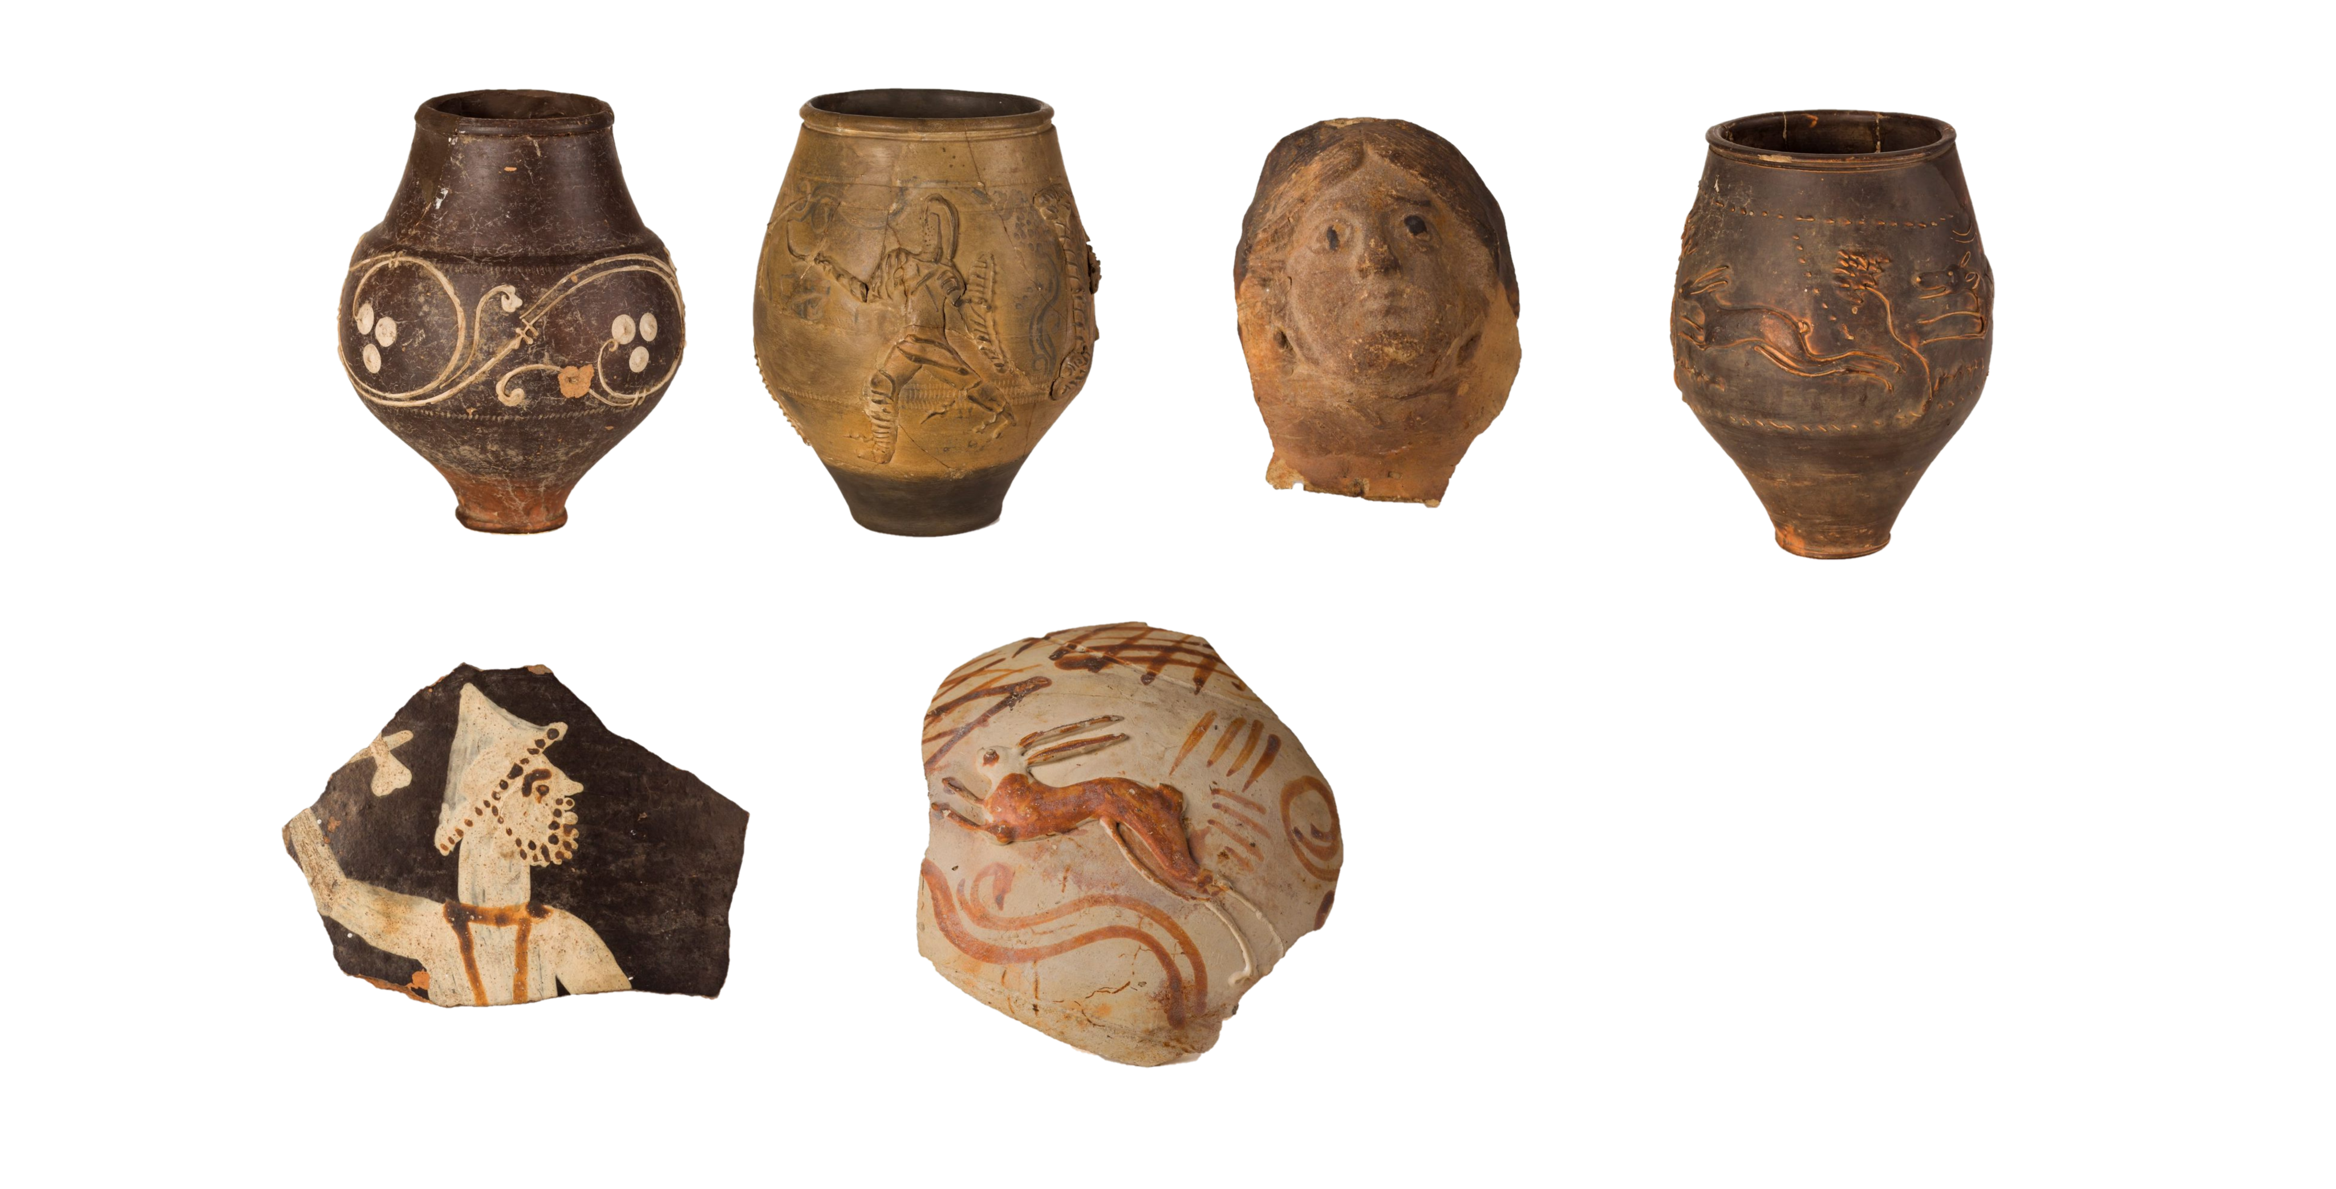
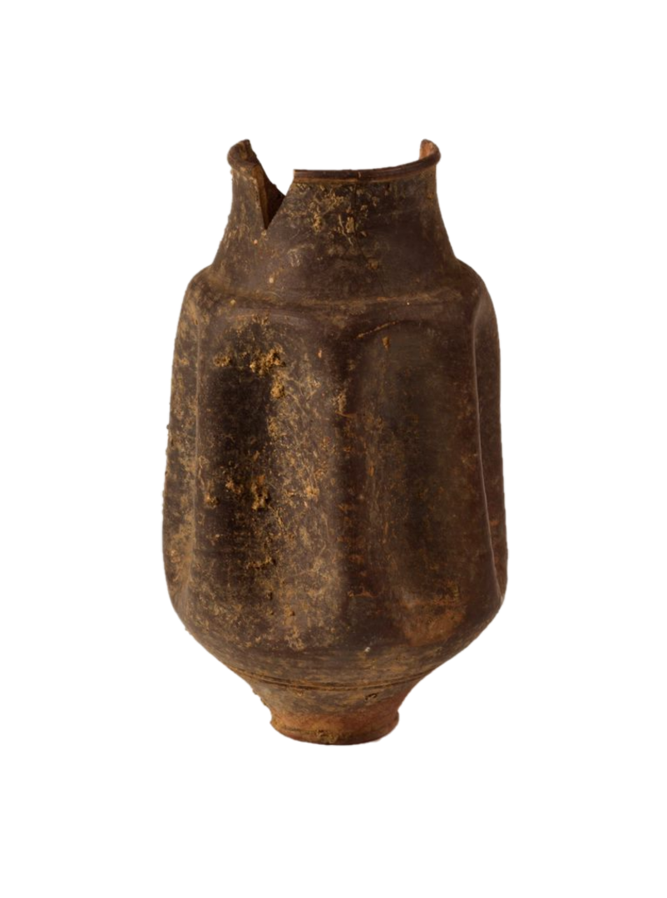
Roman Pottery
Image bank for schools
Using this resource:
Optional object information is provided within the notes section of some of the slides.
To enable notes in normal view, select the 'View' tab on the toolbar, enable 'Normal' and then 'Notes'.
To enable presenter view notes on desktop, select the 'Slide Show' and tick the 'Use Presenter View' box.
WWW.PETERBOROUGHMUSEUM.ORG.UK/LEARNING
Images: Produced by Peterborough Museum & Art Gallery and licenced under Creative Commons Attribution-NonCommercial-NoDerivatives 4.0 International (CC BY-NC-ND 4.0)

Slide 2
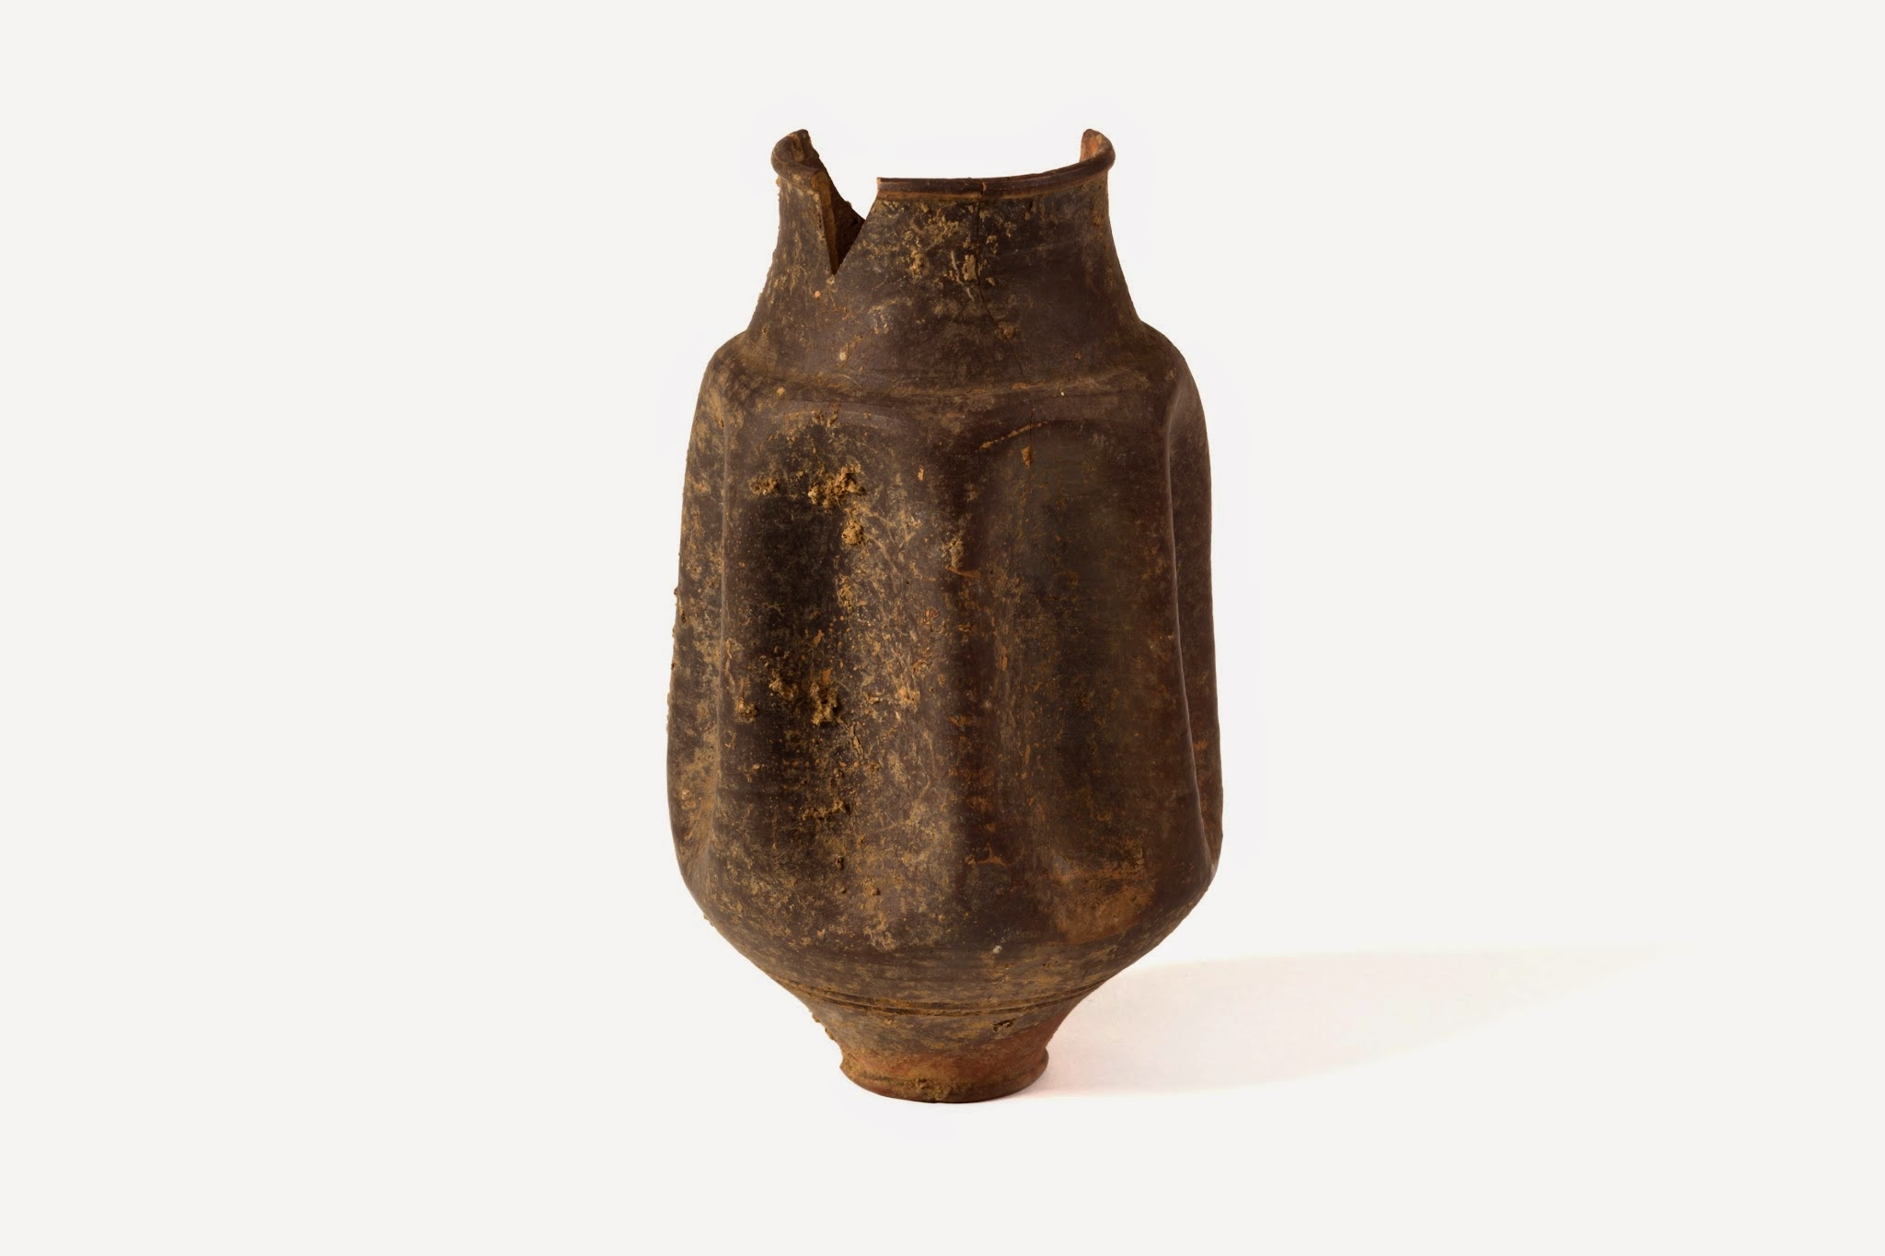
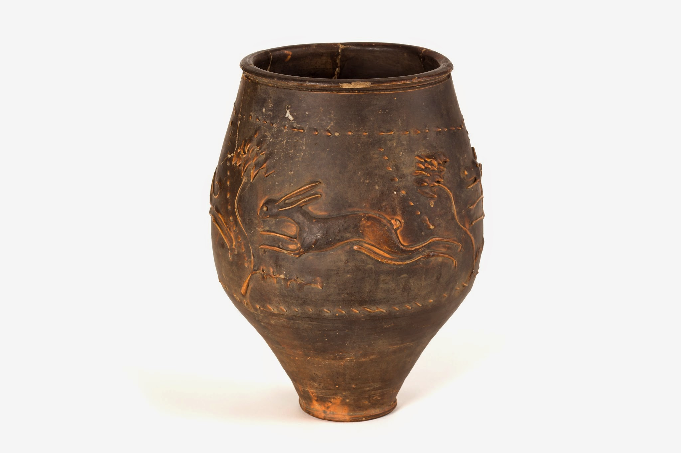
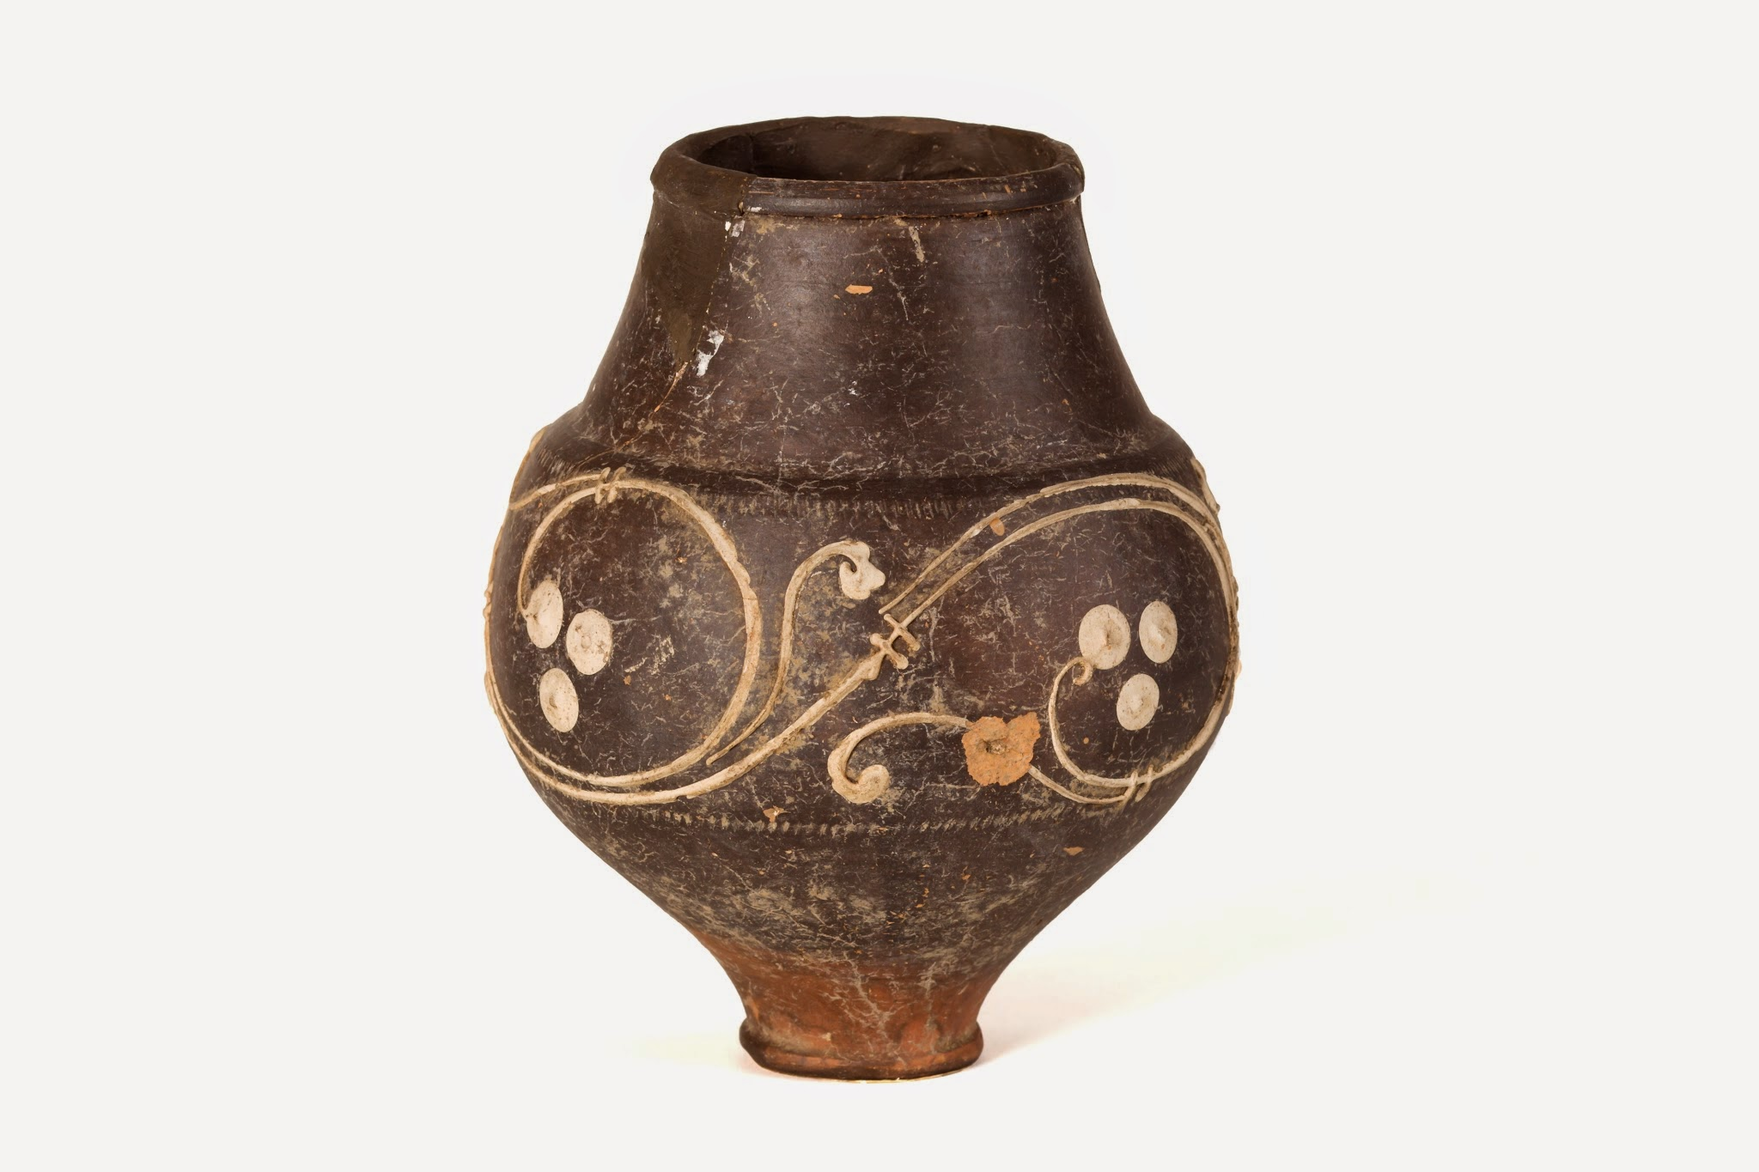
Notes:
To the south west of Peterborough sits the Roman town of Durobrivae. Today the town is hidden under fields, roads and villages, the once bustling walled town with sprawling industrial suburbs lies quietly underneath the ground. But the signs are there if you look closely, and dig a little under the ground and you will find objects sealed for thousands of years. In this resource, you will find some of the Pottery that has been discovered in this area, which was produced in and around the Roman town.
Object: An Indented (folded) Beaker. Lower Nene Valley Colour Coated Ware. These objects are drinking vessels, possibly used for wine. Archaeologists think that the impressions are designed to help you hold to beaker, by giving your fingers and thumb something to grip. This is very helpful if the beakers become wet and slipper, or depending on how much you are drinking. Some have also suggested that the wells created between the depressions help to capture any bits or sediments that may have been in your drink, preventing an unpleasant drinking experience.

Slide 3
Notes:
Object: A globular Beaker with rouletted and Barbotine painted decoration. Lower Nene Valley Colour Coated Ware. Another drinking vessel, though this type of beaker does not have the indented handholds like the last. The white decoration is a white clay, which is piped onto the surface like icing a cake, the design shows grapes on a vine. Because of the large body and narrow base, it will fall and lie at an angle if knocked over, preventing lots of the liquid from spilling out. Whether this was on purpose or not, we do not know, but we think this is a brilliant design perk. If you look closely at the base of this pot, you can see areas of light orange. This is where the Roman potter held the pot, as they dipped it within a coloured slip, this is where they get their name ‘colour coated’. Sometimes it is possible to see the finger prints of the potter, captured within the colour coating and preserved for over one thousand years.

Slide 4
Notes:
Object: A ‘Hunt Cup’ Beaker. Barbotine decoration around the body depicts a hare being chased by a hound. Lower Nene Valley Colour Coated Ware. Like the other two vessels, these beakers were also used for drinking. The style of decoration on this vessels is common to those that were being produced along the Rhine near modern day Cologne in Germany in the 1st C AD. It is believed that potters from this area migrated and settled at Durobrivae, bringing their style and pottery techniques with them. By the 2nd C AD Hunt Cups like the example above, were being produced at Durobrivae and exported throughout Roman Britain.

Slide 5
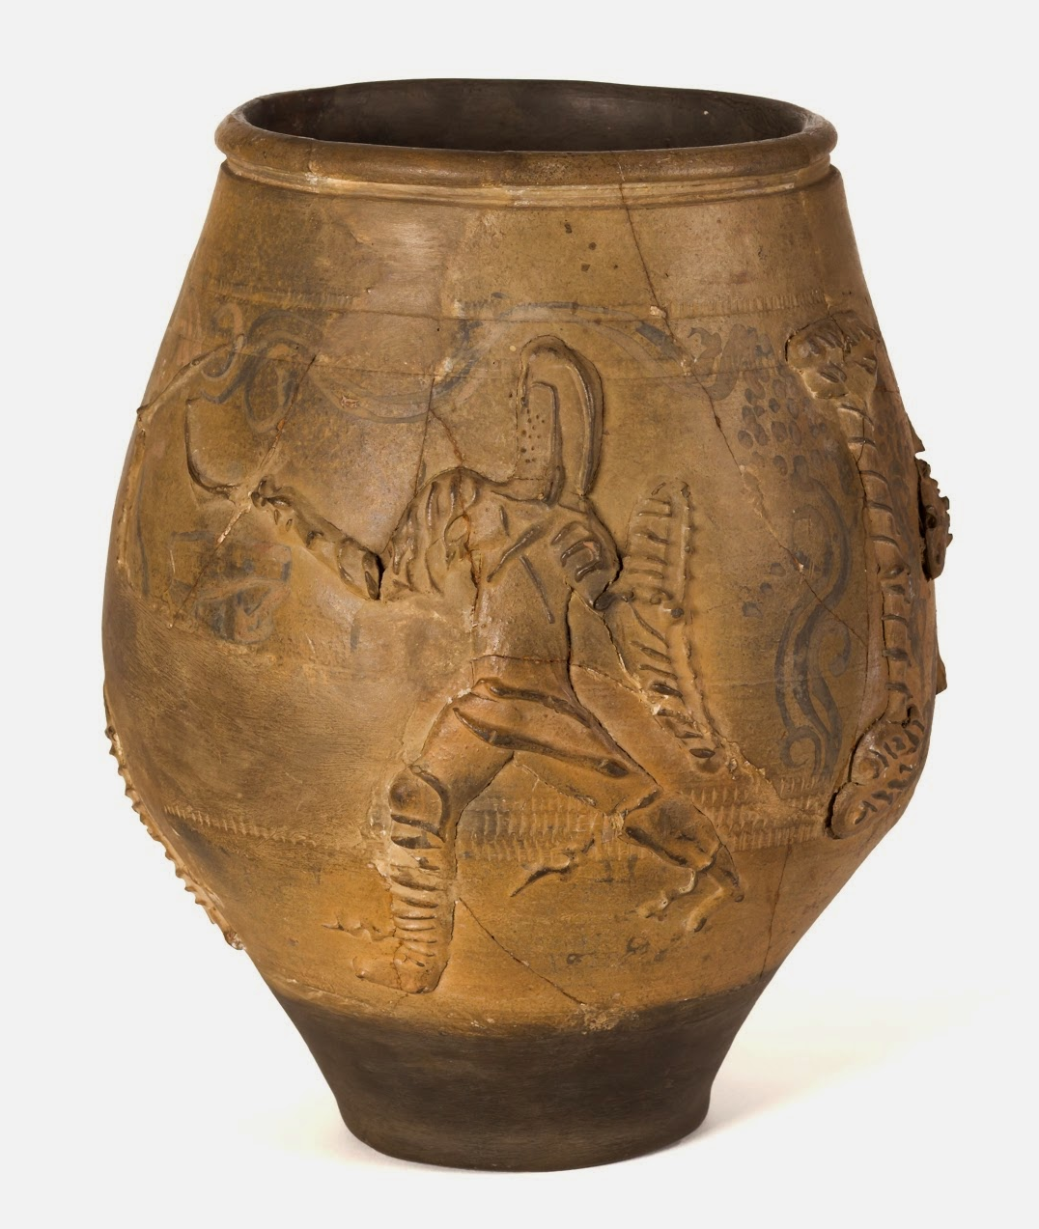
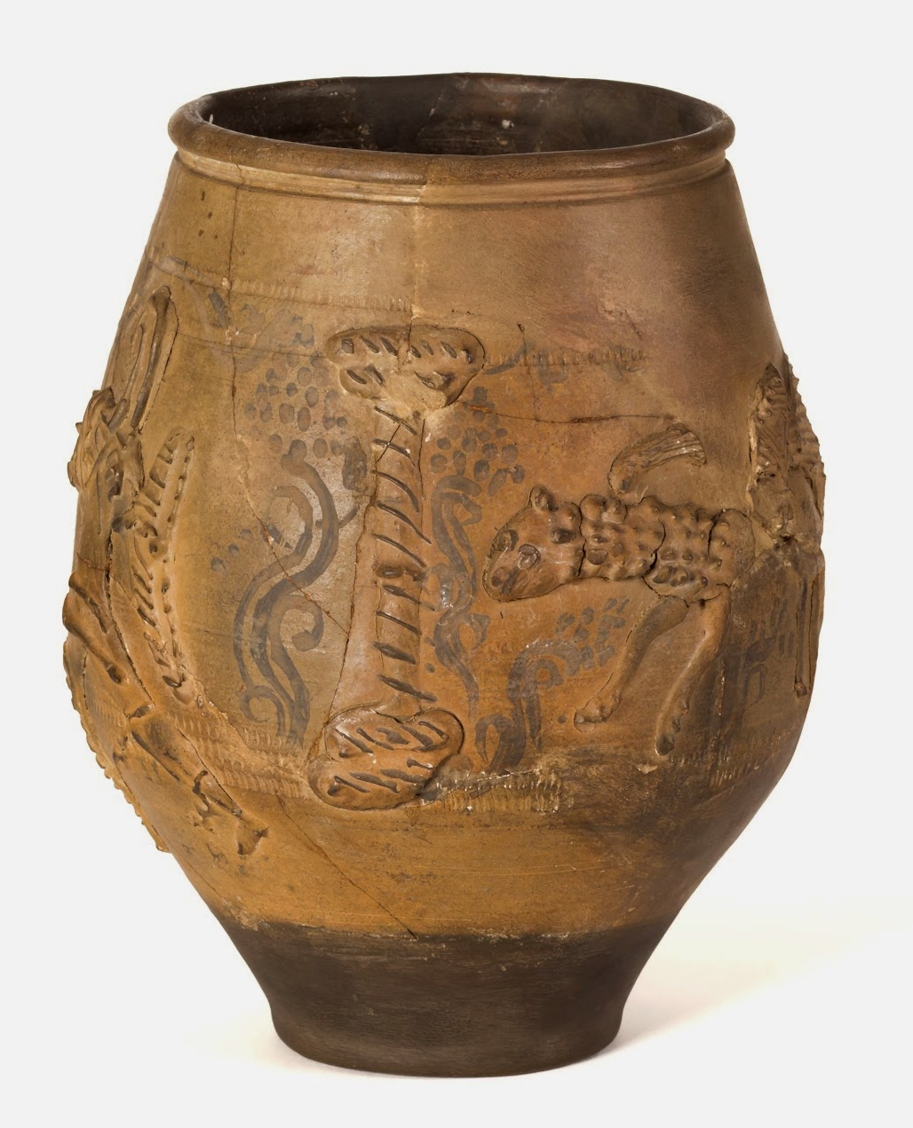
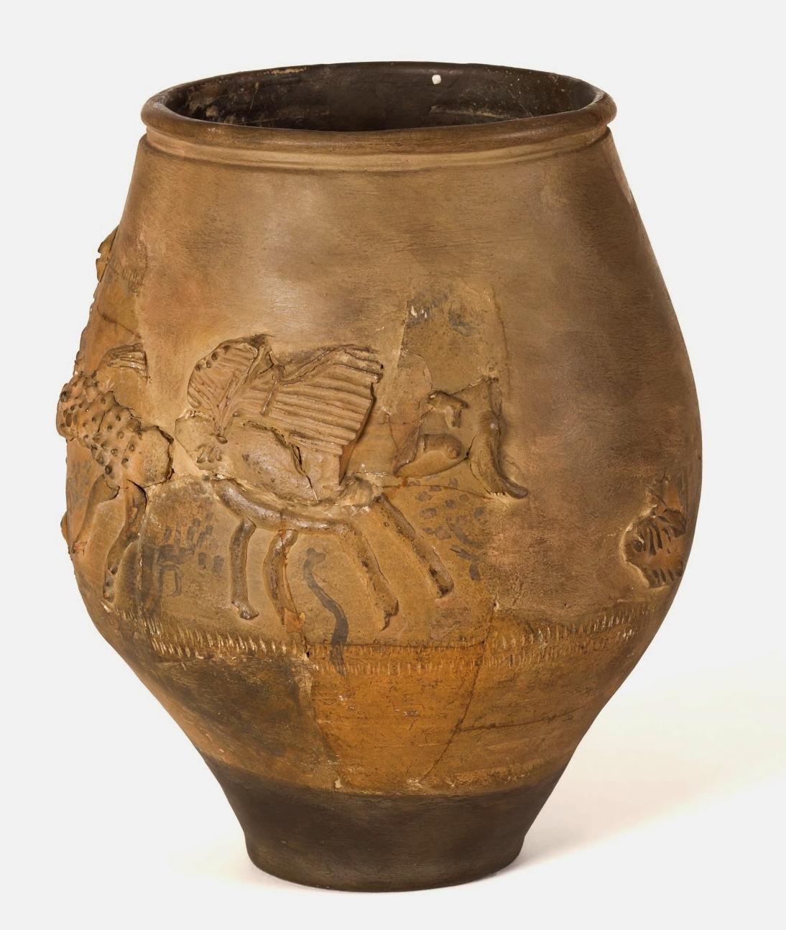
Notes:
Object: Large buff colour coated Jar. Rouletted decoration surrounds the body with two parallel lines on the upper portion and three along the lower body. Barbotine scene depicting gladiator and beast. Abstract painted design of landscape completes barbotine scene. Lower portion and internal surface of jar colour coated in dark brown. Part of the George Wyman Abbott collection. G.W.A.40.

Slide 6
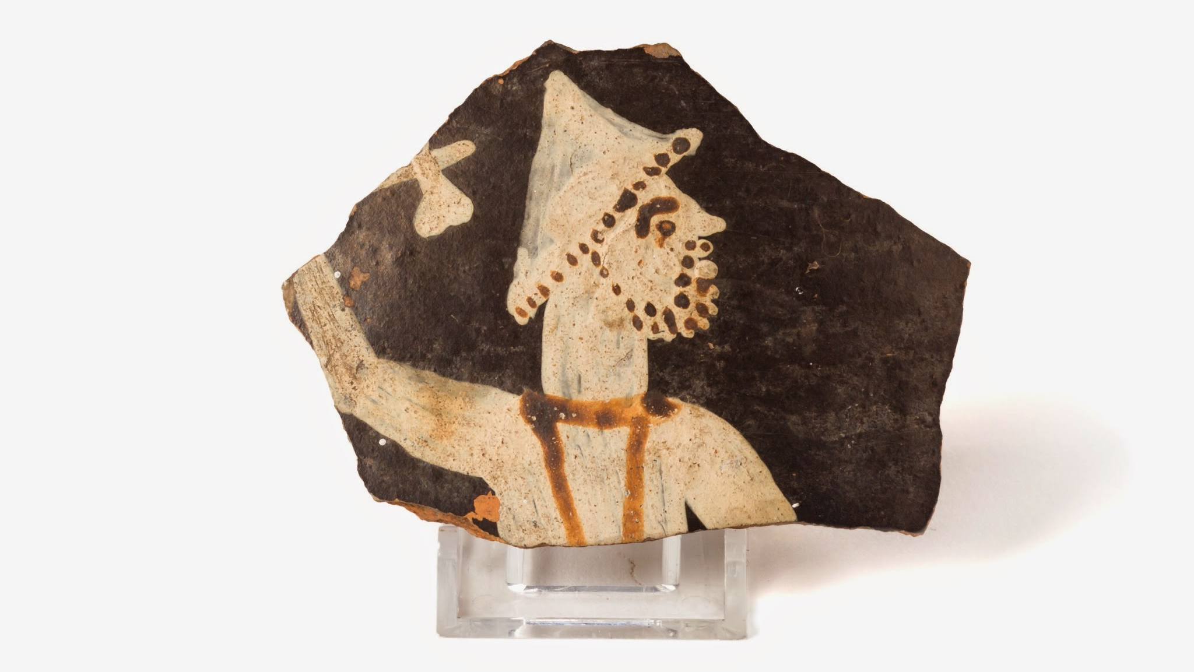
Notes:
Object: A sherd of a Lower Nene Valley Colour Coated vessel. The sherd shows the Roman god Jupiter Dolichenus, which has been painted onto the surface. Jupiter Dolichenus was worshiped by a mysterious cult throughout the Roman Empire, the god is recognisable by his beard and double headed axe.
Sherd: A single piece of broken pottery is known as a ‘sherd’

Slide 7
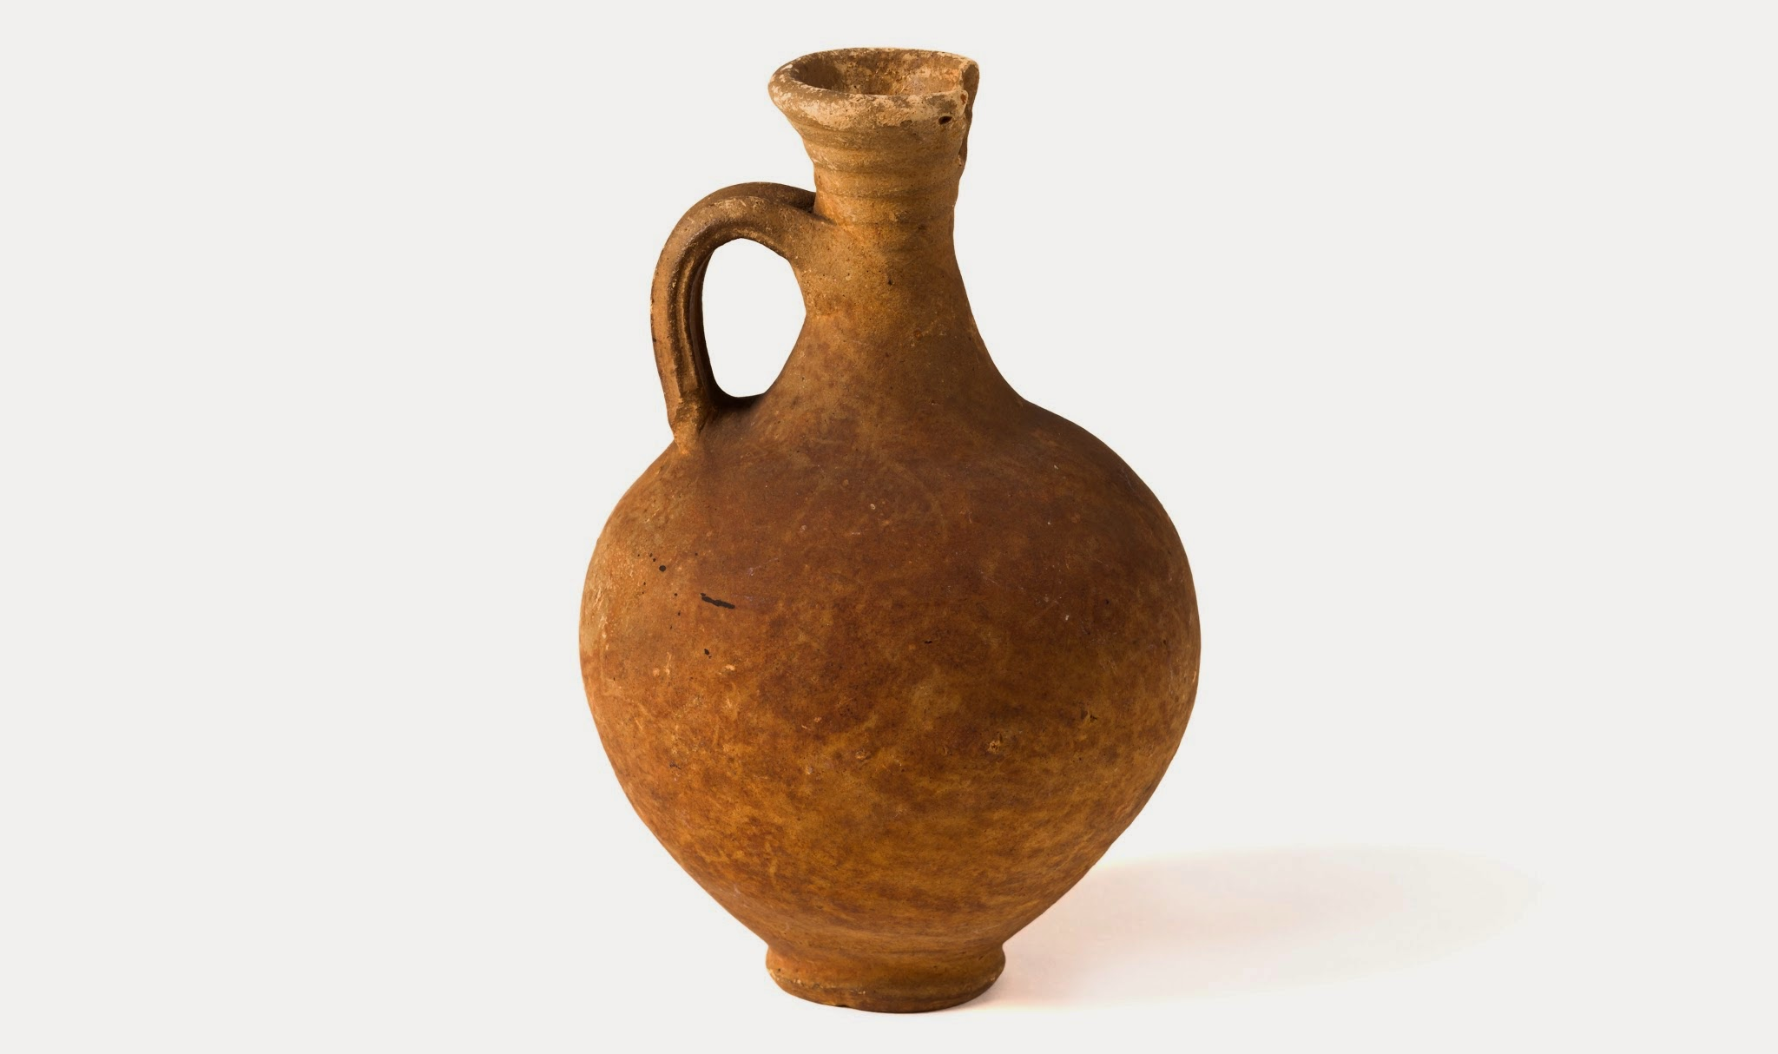
Notes:
Object: Ring-necked Flagon. Cream fabric. Reeded handle. Discovered at Chester House Farm, Irchester, Northants by William Copepers. Inscription on body of vessel reads "I was dug out of the [unknown] by William [Copepers] on Christmas Day, 1839"
Object Number: L47 Object handlist (L 47 CMS)

Slide 8
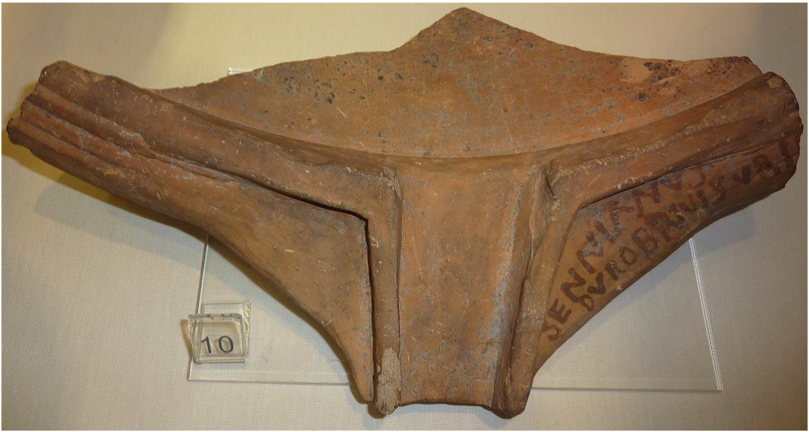
Notes:
Object: Fragment of Mortarium rim with painted inscription by maker "SENNIANVS DVROBRIVIS VRIT". Part of the George Wyman abbott collection. G.W.A.158.
The inscription "SENNIANVS DVROBRIVIS VRIT" means Sennianus fired this at Durobrivae. SENNIANVS is the name of the potter who made this Mortarium, "DVROBRIVIS" is the name of the small roman town to the West of Peterborough, and"VRIT" comes from the latin uro meaning to burn.
Did you notice the different spellings of the potters name? This is no mistake, the Roman alphabet consisted of 23 letters unlike the 26 we use today, because of this, certain sounds were represented by the same symbol. For example there was no distinction between the vowel "U" and the consonant "V", the symbol V is used to represent both sounds. Take the famous general Julius Caesar, their name would have been written IVLIVS CAESAR. Take a closer look at the Roman spelling of Julius – IVLIVS, what other letter is missing and can you work out which symbol is used to represent both sounds?
Latin Alphabets like the modern English Alphabet are still in use today, which is why we can easily recognise and read the letters on the mortaria above. Just as our writing system developed from the Roman Latin, the Roman Latin system developed from other alphabets too, with the earliest example of Roman Latin dating to the 7th Century BCE (700BCE – 601BCE). This means that the Latin Alphabet has been in use for around 2700 years! But Roman Latin can trace it's development further back in time, having developed from the Alphabets of the Etruscans, Greeks, Phoenicians, Proto-Sinaitic and even Egyptian Hieroglyphs. You can see the evolution of the alphabet in this article by the World Economic Forum, use the wonderful chart by Matt Baker to compare the alphabet as it develops https://www.weforum.org/agenda/2022/01/greek-latin-evolution-alphabet-language/

Slide 9
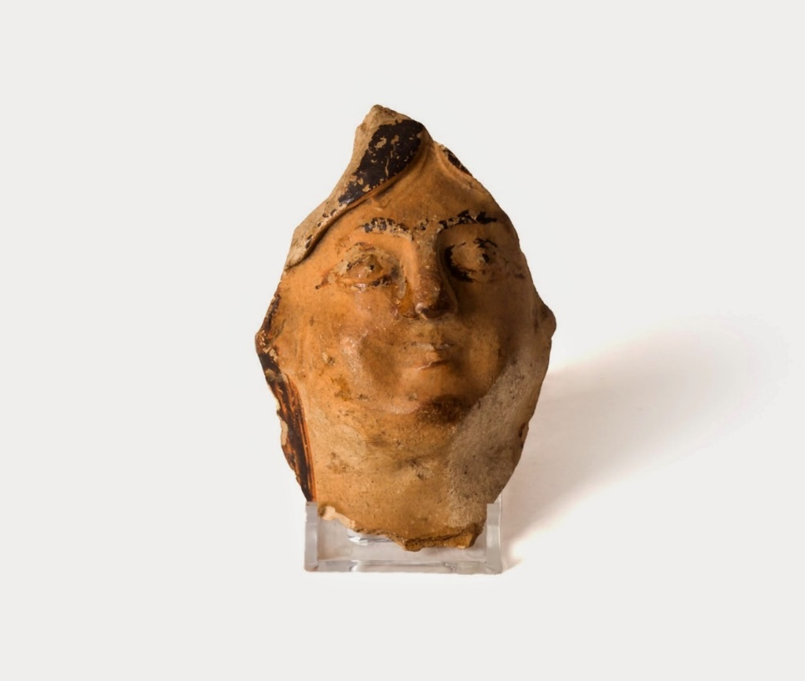
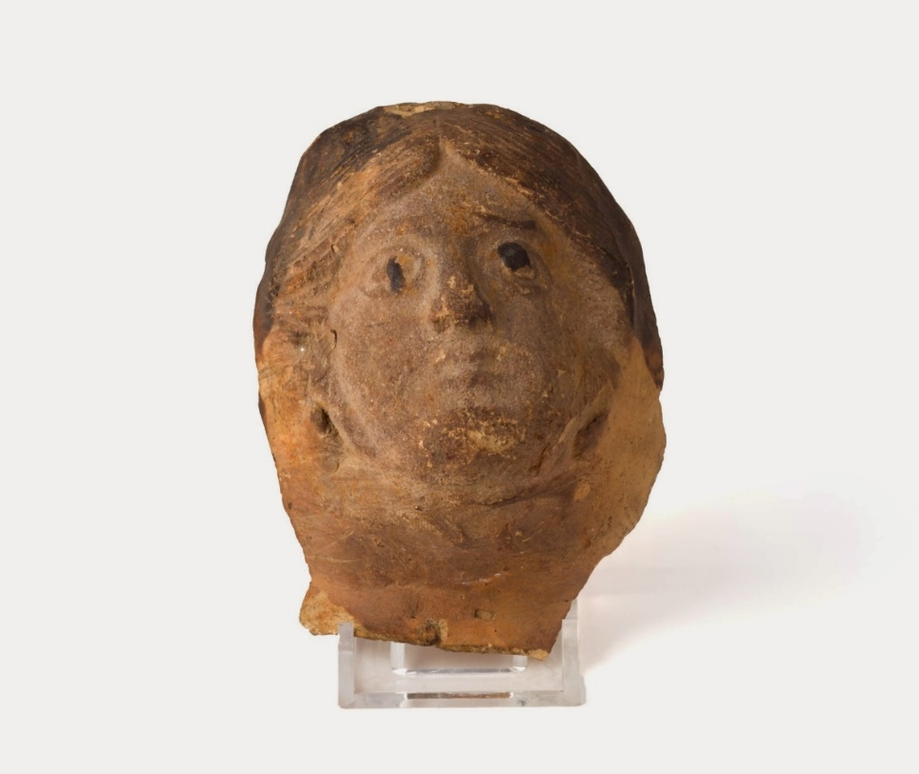
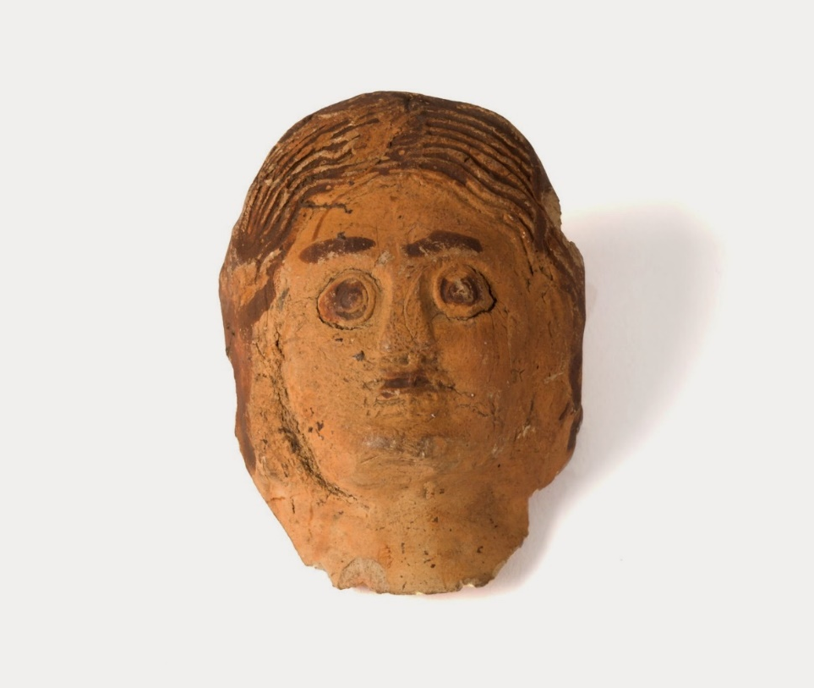
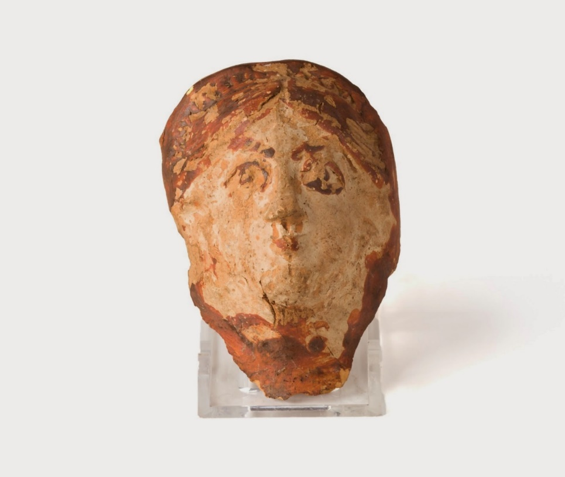
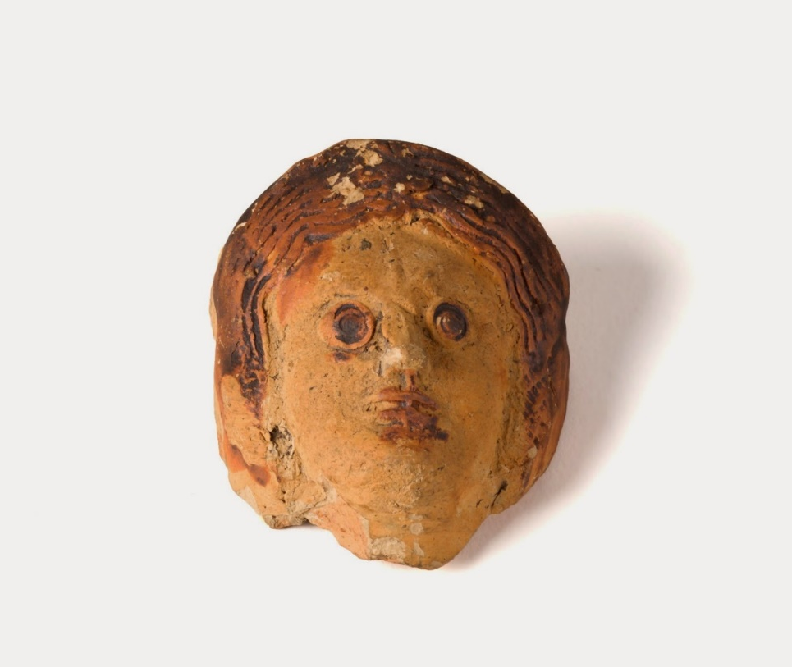
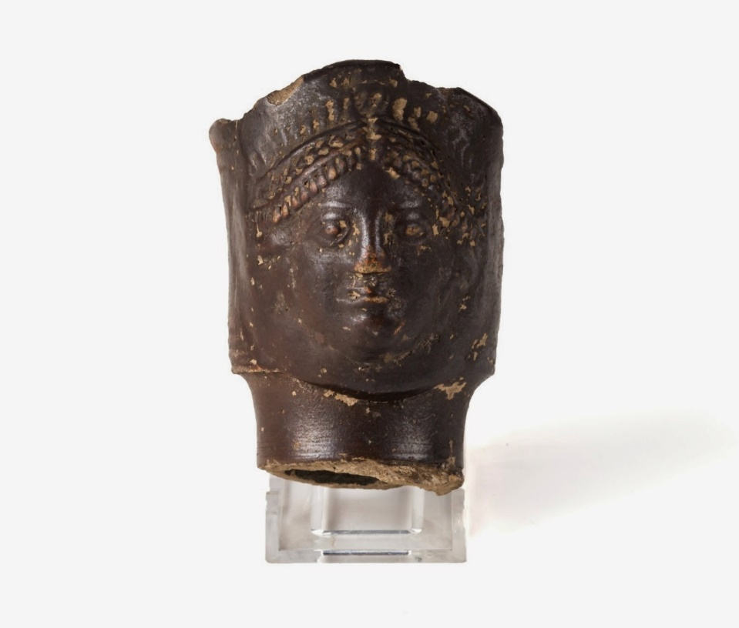
Notes:
Object: Roman anthropomorphic spouts. These faces would have formed the decorative spout to a larger vessel. Top Left: L95 & or L104. Top Right: L102. RB Facemask, female from river mud at Castor. Traces of painted hair, eyes and eyebrows. Location: unknown. Bottom Left: L93 Female head. Face-spout. Features, hair, etc., in brown paint. Castor 1821-23. E.T. Artis Collections.

Slide 10

Notes:
We have chosen one of the face spouts from slide 9 and imagined what is may have looked like in the past. This is known as interpretation. We have used our skills of observation and research to inform our own interpretation, which can be found on the following slides, with a full example on slide 12.
As a class or as individuals, have a go at seeing what clues you can observe on the spout fragment above, and then use the image bank to look at the other types of pottery Roman pottery found within the Peterborough area. Were there any that were also ‘Flagons’? This will help you imagine the form or shape of the vessel the spout was once a part of.

Slide 11
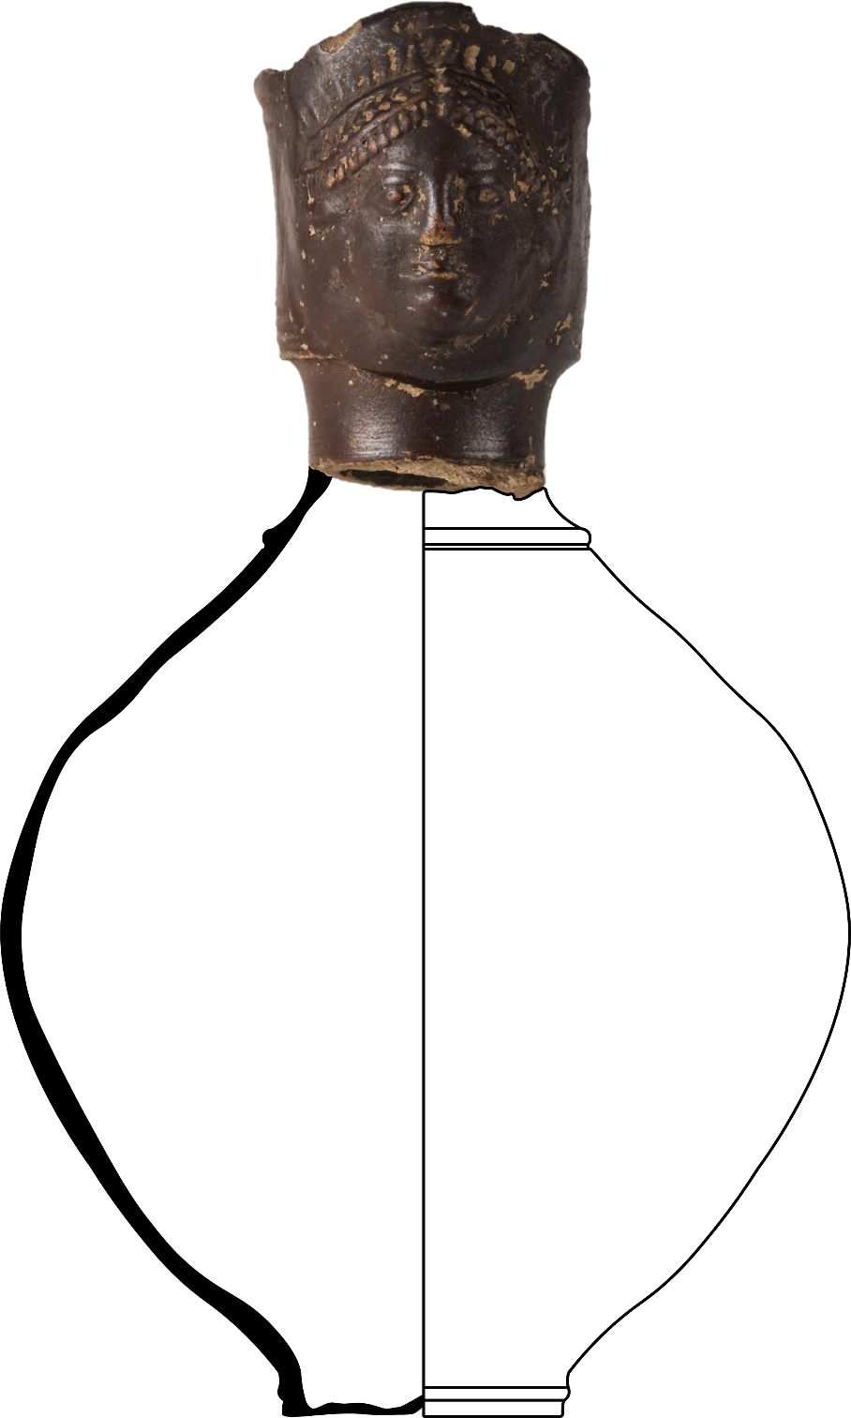
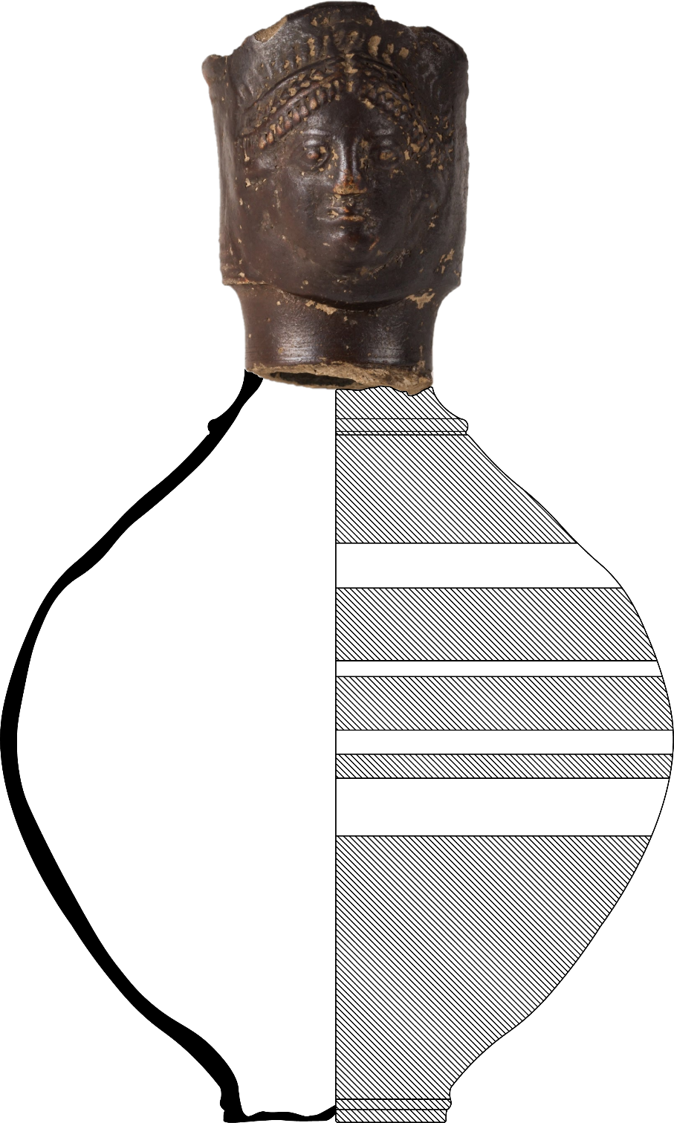
Notes:
When archaeologists draw pottery, they divide the pot into two halves, shown by the line running down the middle of the pots silhouette. The left side shows a cross section or cut away of the pot and demonstrates how thick the clay is all around the outside. Archaeologists use measuring devices called callipers to carefully measure the thickness of the pot. The right side of the drawing shows the surface of the pot and any decoration that can be seen there. It isn’t very common of pots to survive intact over hundreds or even thousands of years, so sometimes we only have the fragments known as ‘sherds’ to work with. We piece the pot back together as best we can and then using our observations, research and a little imagination fill in the gaps.
You can learn all about how archaeologists draw with this fantastic resource from the Young Archaeologists Club https://www.yac-uk.org/userfiles/file/1429014915_Artefact_investigation.pdf

Slide 12
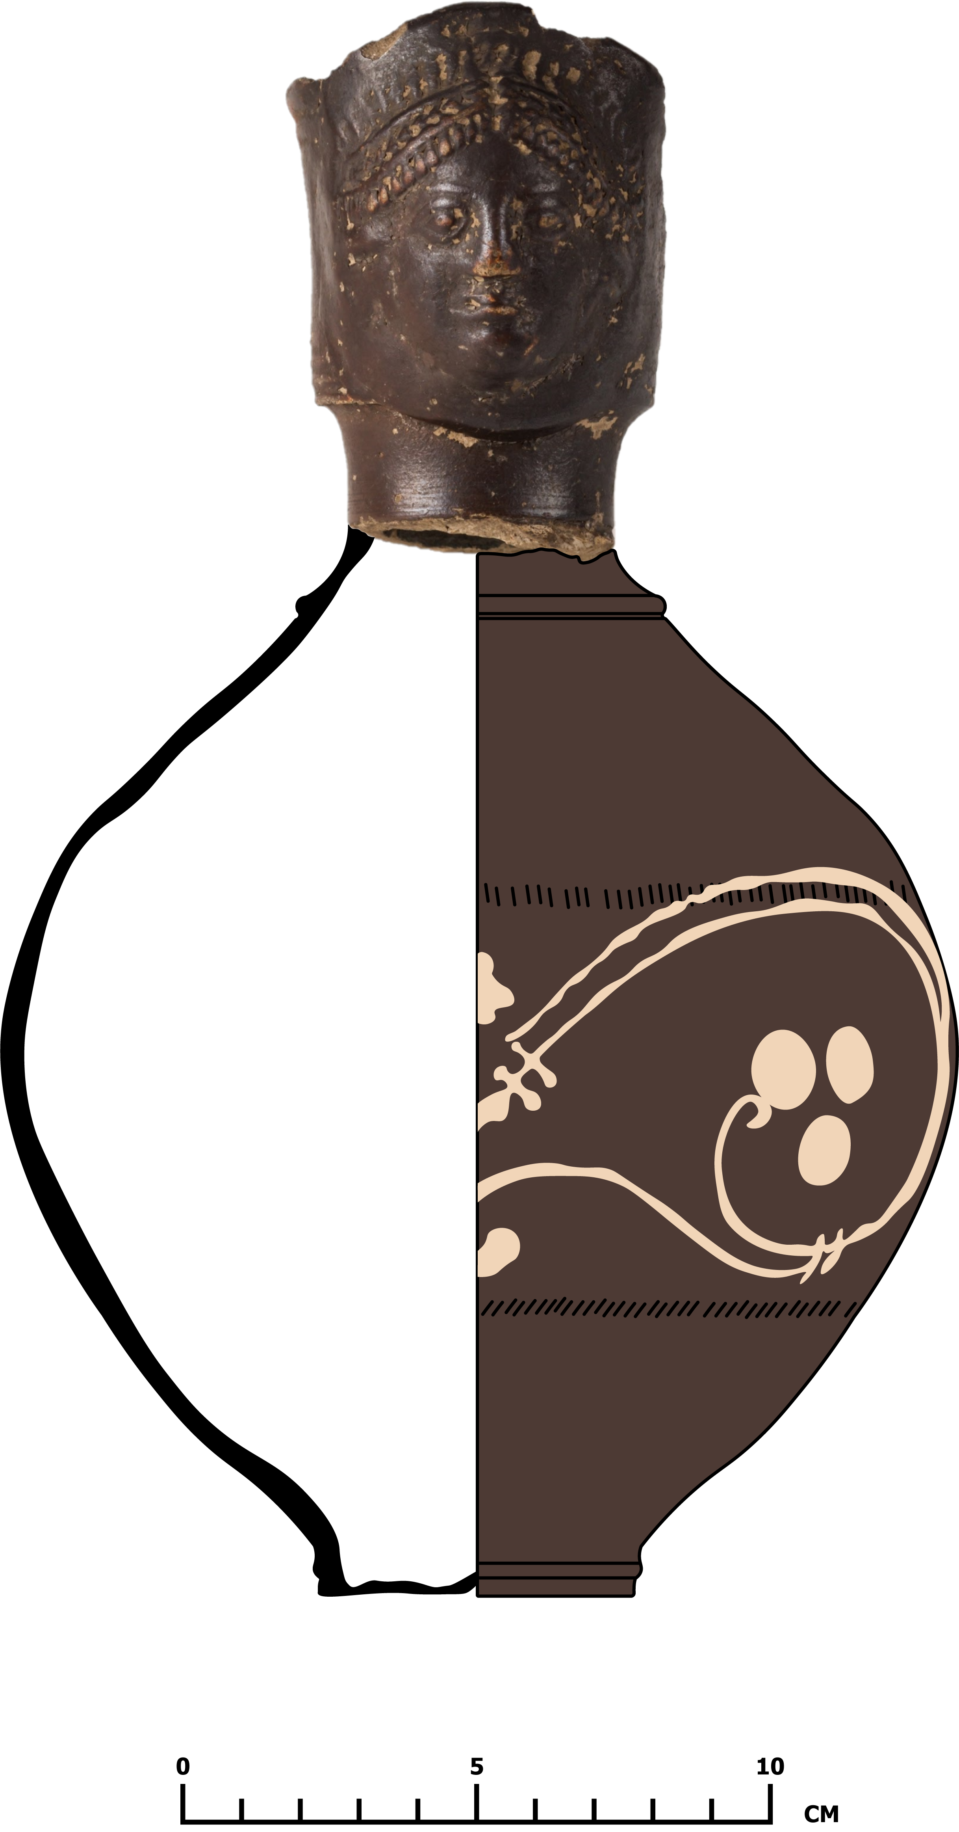
Notes:
Here we have imagined the kinds of decoration this flagon may have had, we have used evidence from what we have observed and from our research to create this interpretation.
From the evidence we gathered through observation, we decided to add these decorations.
The pot has been Colour Coated brown to match the evidence provided by the surviving spout.
A 'Rouletted' decoration has been added. Rouletting is the name given to the incised (cut) pattern running around the vessel.
In Archaeology the term Rouletting has been used interchangeably with and sometimes incorrectly in place of another technique known as 'Chattering'.
A Barbotine white slip decoration depicting a vine and grape (Scroll and Berry) motif common amongst Nene Valley Colour Coated Ware vessels of the 3rd-5th centuries AD has been painted or dripped onto the surface, the pattern used here has been copied from the pot shown earlier. Take a close look at the decorations, which was added first, the rouletting or the barbotine pattern? Being able to distinguish the sequence of events is an important skill for Archaeologists.
To create a Rouletted pattern a thick toothed wheel is held against the pot as it is turned on the wheel, this creates a uniform ring of incisions around the pot. (imagine a modern pizza cutter, with a thick cog where the blade would be)
Chattering involves holding a trimming tool against the pot as it is turned on the wheel, as the pot turns the tool skips along the surface creating a similar but irregular pattern, sometimes described as 'rippled'. Have a look at the pattern created on this pot, is it uniform or irregular? Which technique do you think has been used?
Our Observation
The first step we took, was to examine the part of the pot that has survived. The observations we make of objects can tells us a lot about what they may have looked like or their uses.
We decided that the pot was made of a fine clay material and that no course inclusions had been added. The core of the pot and areas of ware are a brownish yellow, the surfaces of the object however are a dark brown, This tells us that this pot has been colour-coated (dipped and coated in a darker clay mixture). The spout has a narrow neck and separated from the rim by a slight flange (a surface that sticks out from an object) with tall concave rim that is simply decorated created by moulding the clay into rings and grooves, more clay has been added over the top to create the face attached to the spout. The face is very detailed, showing an individual with a richly decorated headdress, unlike some of the others we have looked at, we cannot see any sign of painted decoration on the face.

Slide 13
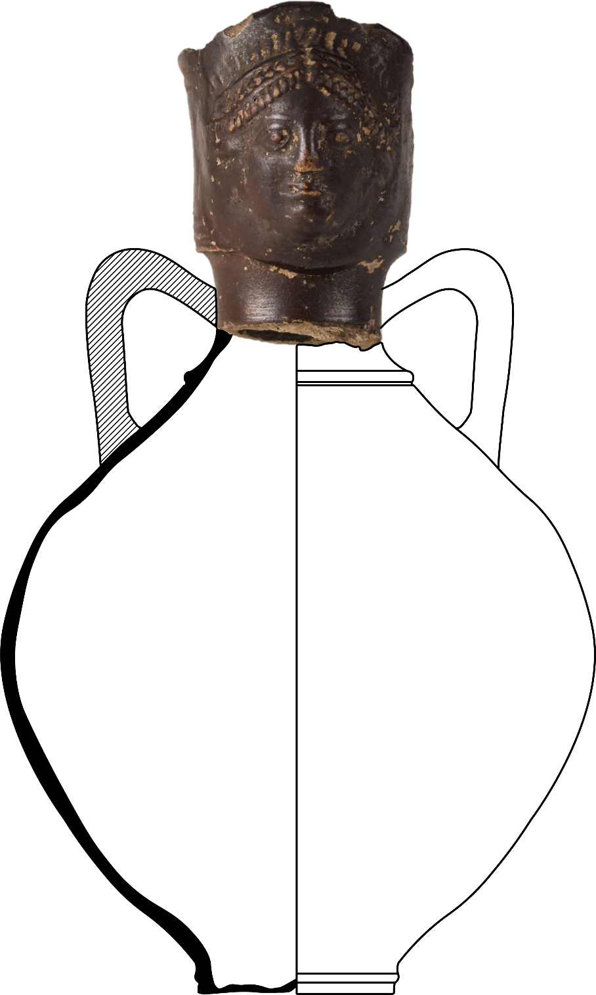
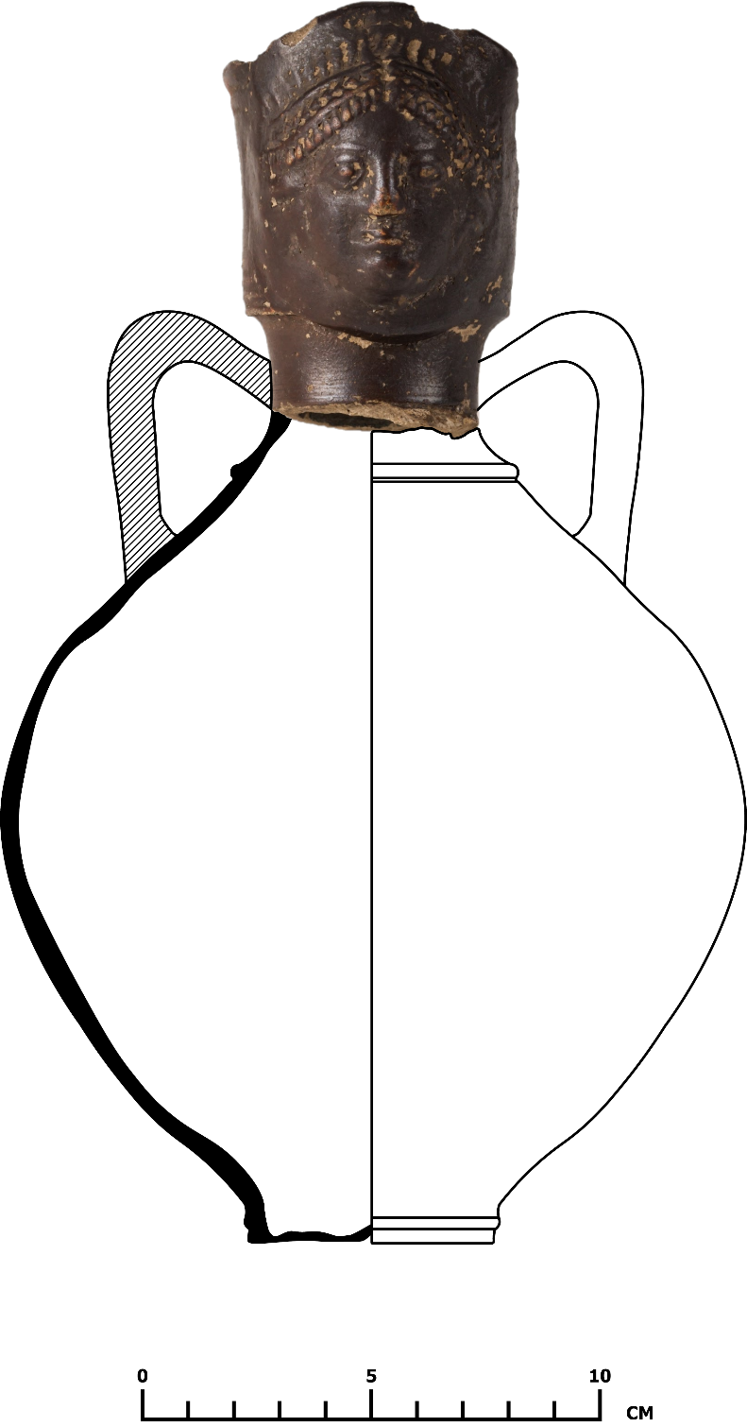
Notes:
We have added some handles to our Flagon to make is easier to hold based on other types of Roman flagons, but this is just one interpretation. What shape and form do you think this vessel would have had?
You can find this sheet on our resources page, available to download and use as a colouring in sheet. https://peterboroughmuseum.org.uk/files/museumArtGallery/Design-a-Roman-Face-Spouted-Flagon.pdf

Slide 14
Activity: Thinking and drawing like an Archaeologist
This pack has shown some of the ways Archaeologists use observation and evidence gathering to interpret objects from the past. By interpreting objects, we can begin to tell stories about how they may have been used, putting them into context and using stories to connect the people in the present with the past.
Have a go at drawing like an Archaeologist by designing your own pot. Remember to show your pots in two halves, with one side showing the vertical cross section and the other the surface of your pots.
Take inspiration from the pots you have seen or use your imagination to design your own pots. The pots in this pack can be used for reference.
Use the observation and interpretation skills of an Archaeologist to explain why your pot was designed the way it was, can you create a story that connects the past and the present.
Start by thinking about how your pot would be used and who the pot will be for. Is it going to be displayed in your home, only brought out for special occasions or to impress guests, given away as a gift, or will it be used as part of your day-to-day life for storage, to cook with, or to serve food and drink in.
Think about the types of vessels and containers you have at home. Do you have plates and cups you use every day? Maybe you have treasured versions that are only brought out for special occasions or are perhaps they are never used at all and instead are displayed in a cabinet or on the walls.
How will these decisions impact on the form your pot will take, the materials it is made of and how or if it is decorated. Return to the Roman pots shown in this pack, try to put yourself in the shoes of our Roman potter and ask the same questions about those pots. What decisions was our potter making and who were they making these pots for?
Prompts
What is my pot used for? Is it for cooking with or maybe for impressing guests at a party?
Who is my pot for? Will you use this yourself or will it be a gift?
What shape is my pot? Will it be held like a cup and need to fit the hand, or will it need a spout to pour liquids from?
What materials will you use? Coarse or fine and why? (prompt: is one better than the other, or is it different for their use)
How thick will your pot be? Is it delicate or robust?
What decorations will you add? Use the pots we have explored to inspire, but do not limit yourself. If you were a Roman potter, how would you make your decorations?
Do your decorations tell a story or have a meaning? Perhaps they depict gladiators in the arena, grapes growing on a vine or maybe religious imagery.

