Slide 1
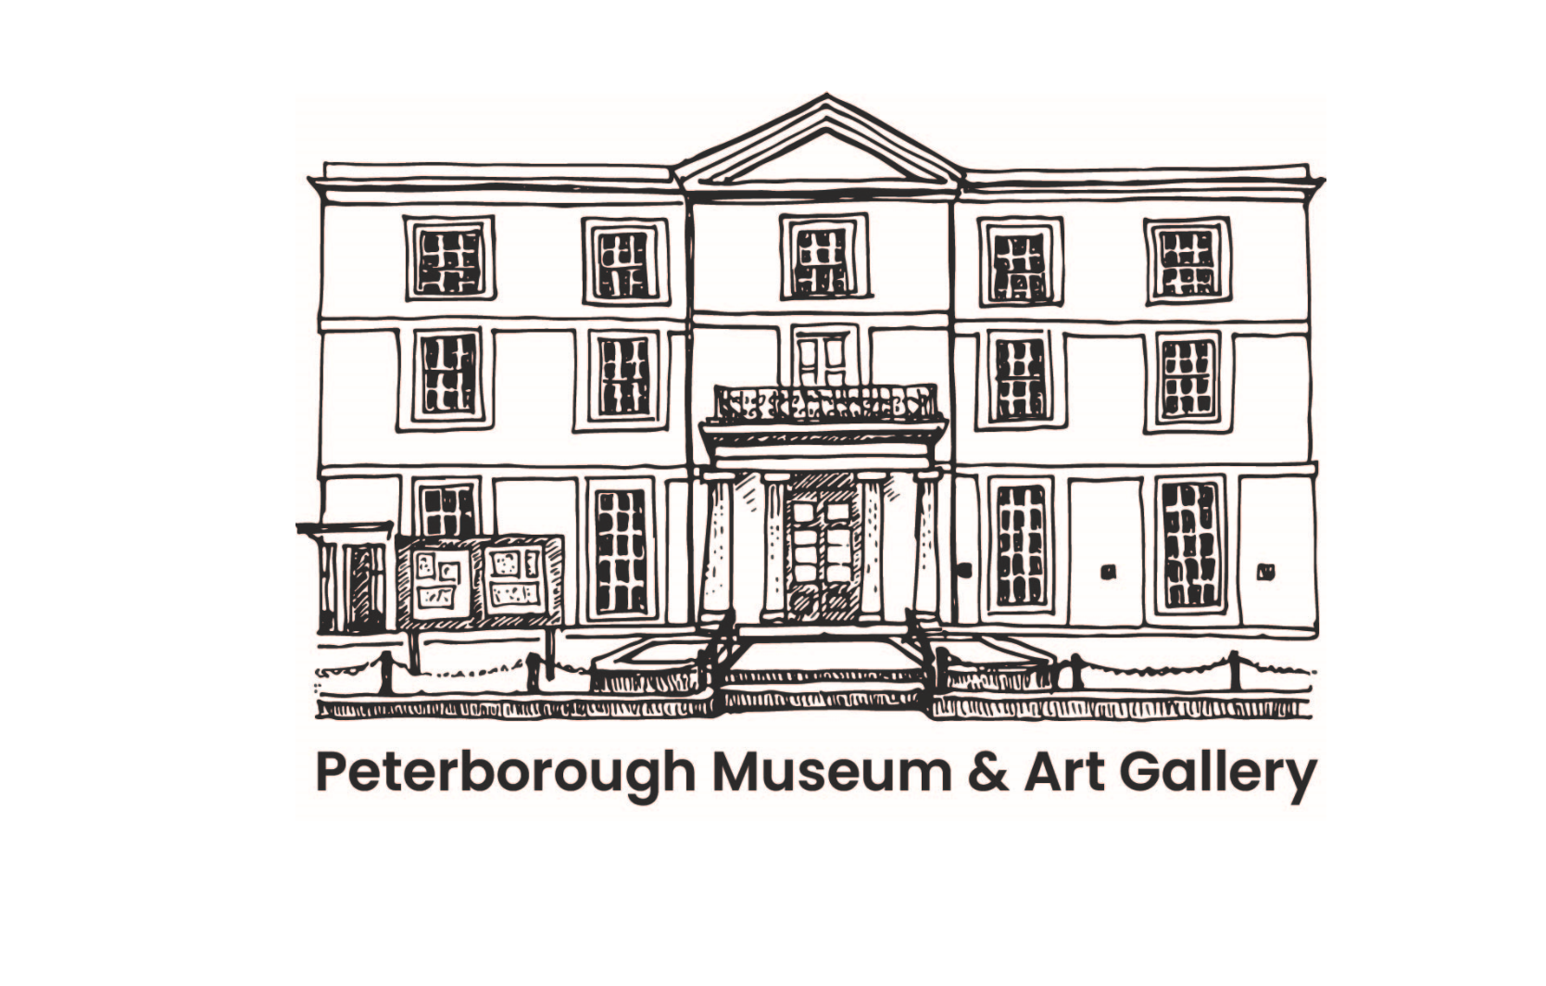
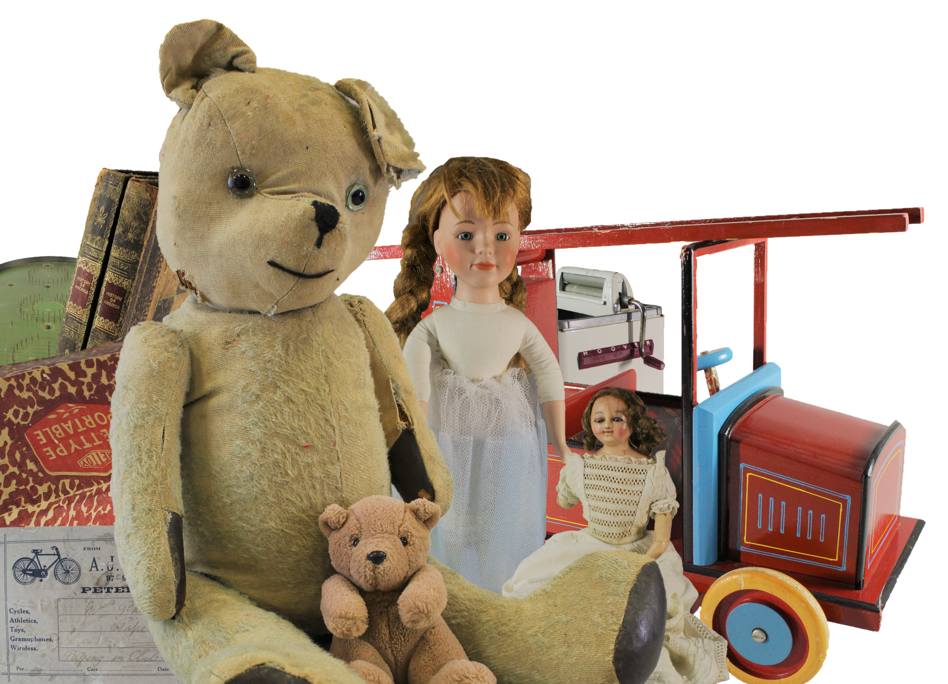
Toys from the Past
Image bank for schools
Using this resource:
Optional object information is provided within the notes section of each slide.
To enable notes in normal view, select the 'View' tab on the toolbar, enable 'Normal' and then 'Notes'.
To enable presenter view notes on desktop, select the 'Slide Show' and tick the 'Use Presenter View' box.
WWW.PETERBOROUGHMUSEUM.ORG.UK/LEARNING
Images: Produced by Peterborough Museum & Art Gallery and licenced under Creative Commons Attribution-NonCommercial-NoDerivatives 4.0 International (CC BY-NC-ND 4.0)

Slide 2
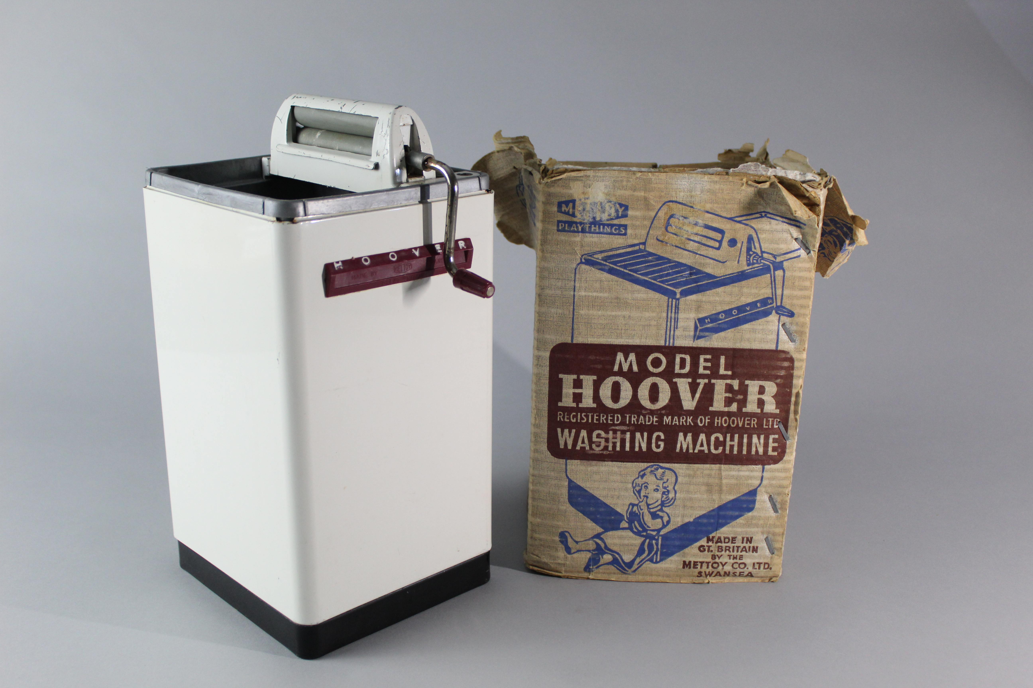
Notes:
Object: A model of a Hoover brand washing machine and mangle, complete with original packaging. Made by Mettoy Company Limited of Swansea in the Mid 20th Century. The table seen on the packaging to the side of the mangle is currently missing. The mangle and spinning washing machine drum are mechanical and can be spun by turning the cranks, one on the mangle visible in the photograph and one unseen, on the rear of the model.
Material: metal, cardboard, plastic.
How do we write a description?
To write object descriptions, you must first research them. To roughly date this toy we were able to research the company and use the information on the box to provide clues to the objects age. One clue is in the bottom right on the box and reads "MADE IN GT. BRITAIN BY THE METTOY CO. LTD. SWANSEA". From our research we knew that the Mettoy Swansea factory was first opened in 1949 by King George VI, this means that our toy must have been produced sometime after this, probably in the 1950’s. In historical research, events like this create known reference points in time. The building of the Swansea factory creates what is known as a terminus post quem, this is Latin and means "limit after which" or in simple terms a point in time after which an event must have occurred, the toy here could not have been made before 1949 because the factory did not exist, we can safely then assume it dates to sometime after 1949. The opposite concept is known as terminus ante quem, which means "limit before which", or a point in time before which an event must have occurred. For example an object found underneath the foundations of a building must have been placed there before the building was built. If you know the date of the building you can assume the object must be no later (younger) than that date.

Slide 3
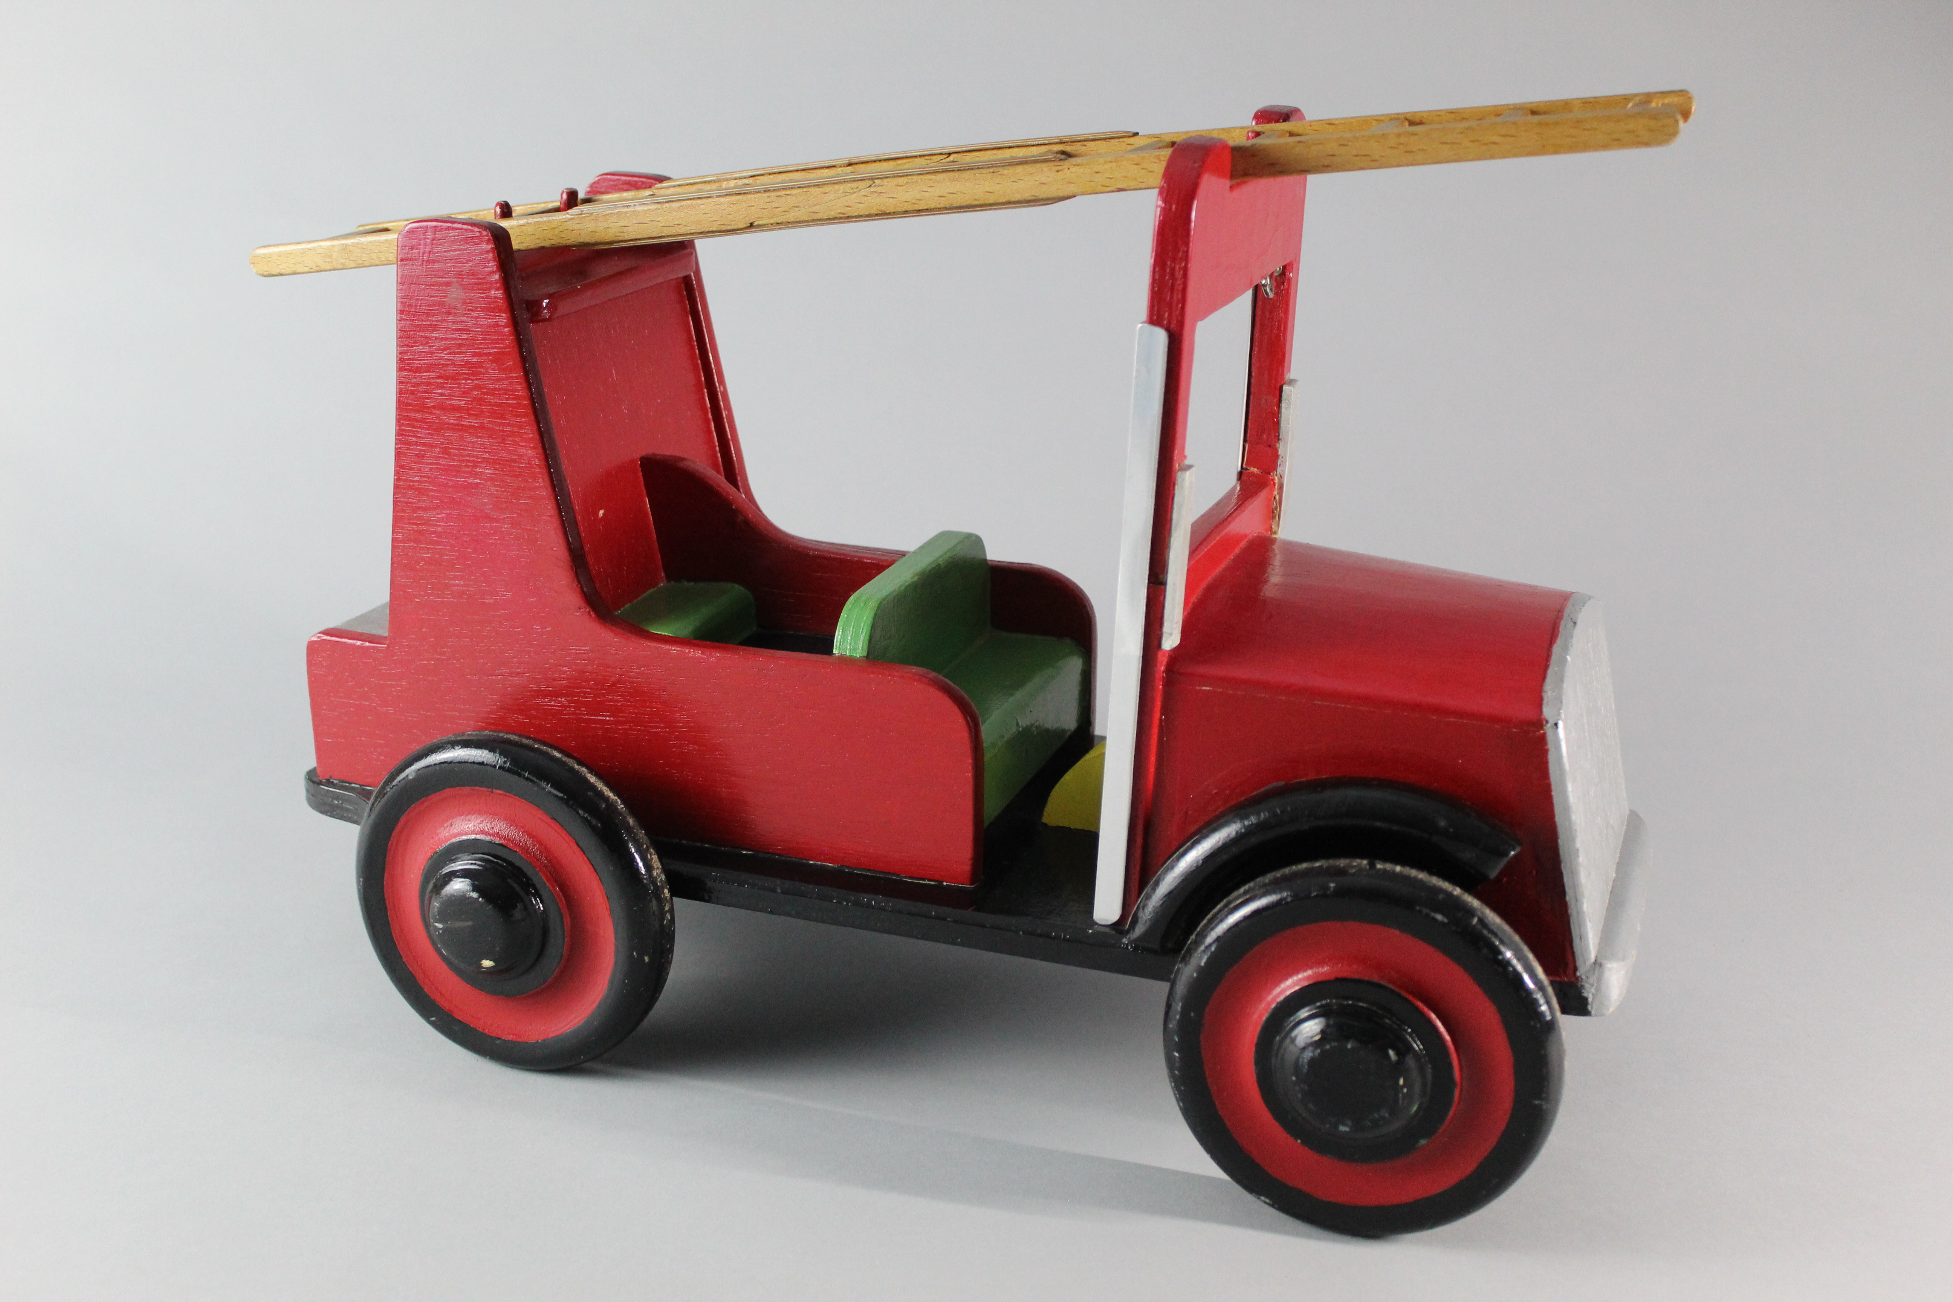
Notes:
Object: Wooden model fire engine, painted red, with black, green and silver details. The main construction is of wood, with metal fastenings. Unknown manufacturer.
Material: wood, metal
This wonderful wooden fire engine is one of two in our collection about which we have very little information. Perhaps they are home made or were created by a skilled craftsperson.

Slide 4
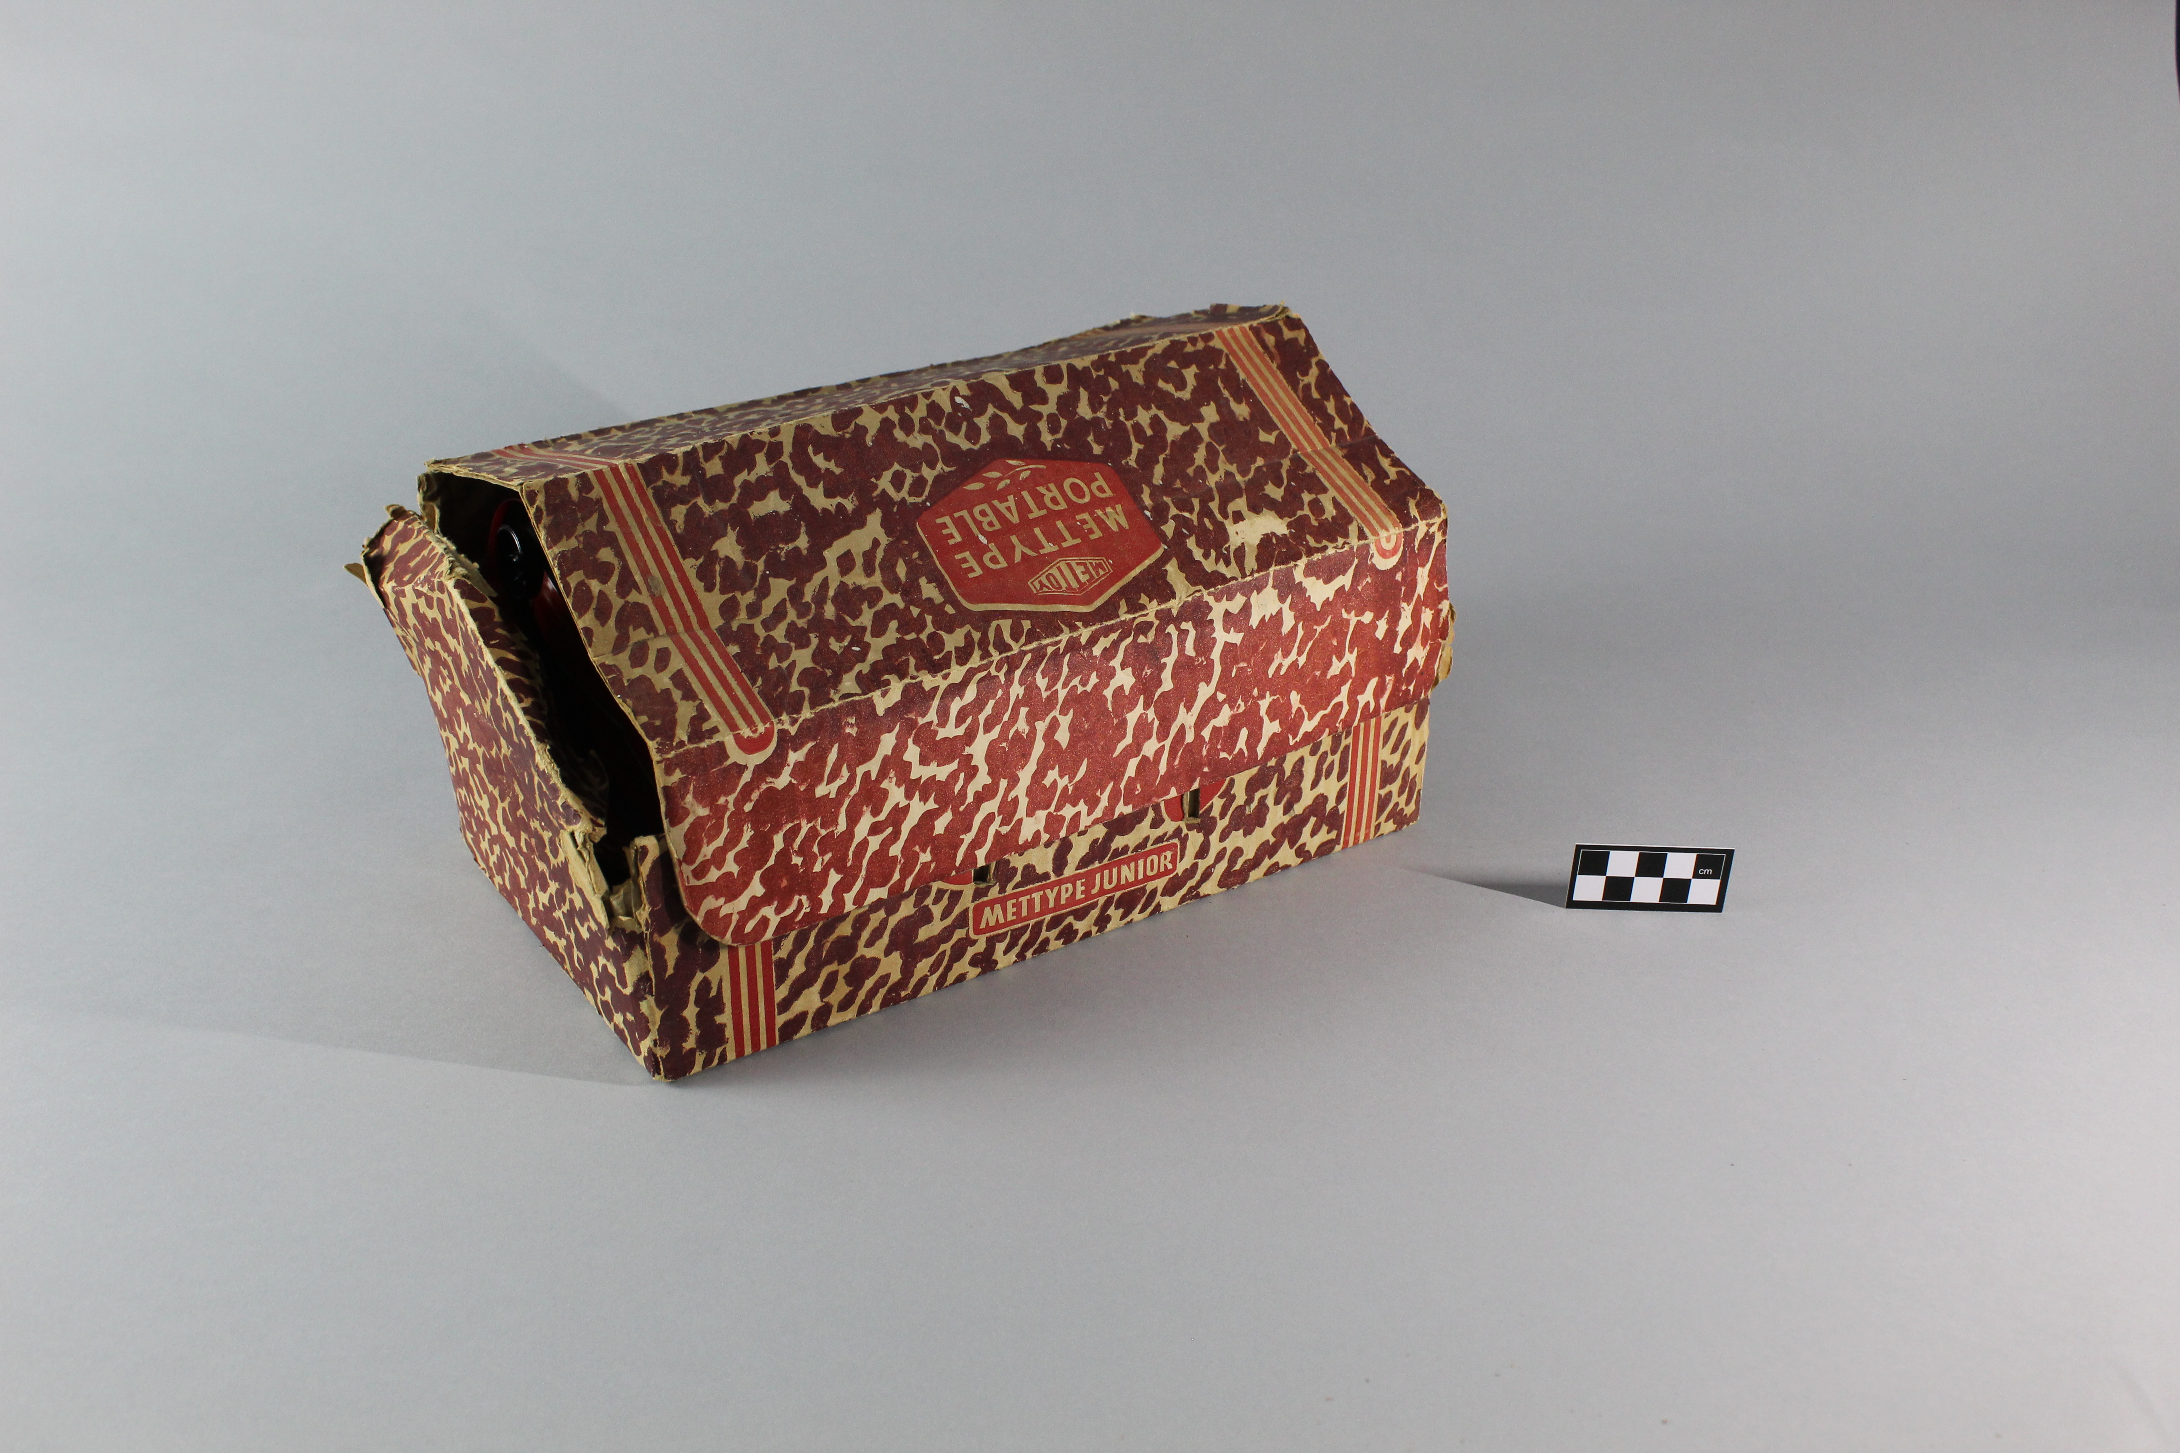
Notes:
Object: The original packaging for a Mettype Junior lithographed tin plate typewriter. Made by Mettoy Company Limited, in the 1950's
Material: metal, cardboard, plastic, textiles
What’s in the box?
The next slide reveals the object hidden inside. Can you guess what it may be, does the packaging give you any clues? Compare this packaging to a modern toy, what differences are there?

Slide 5
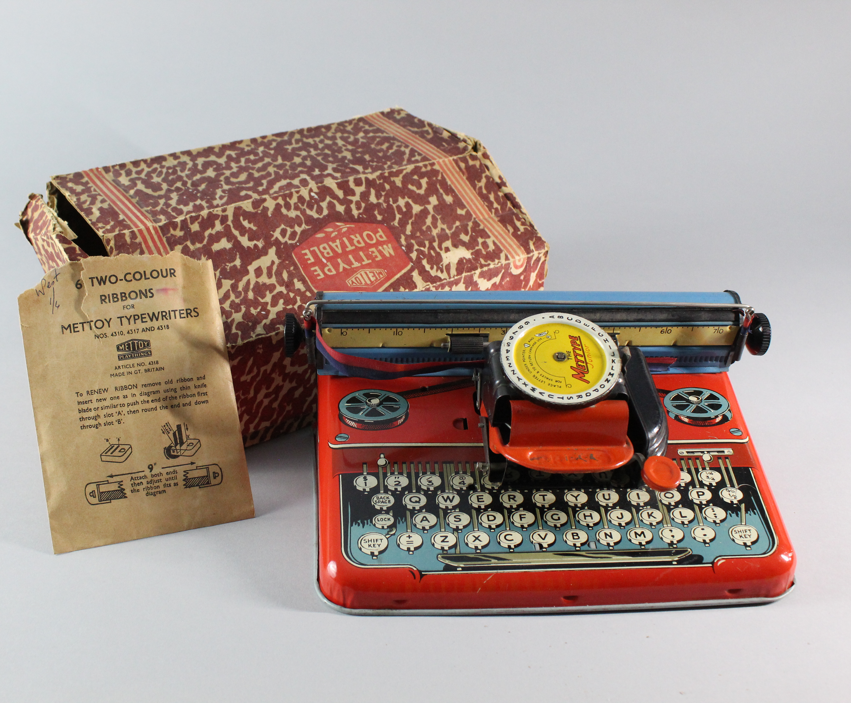
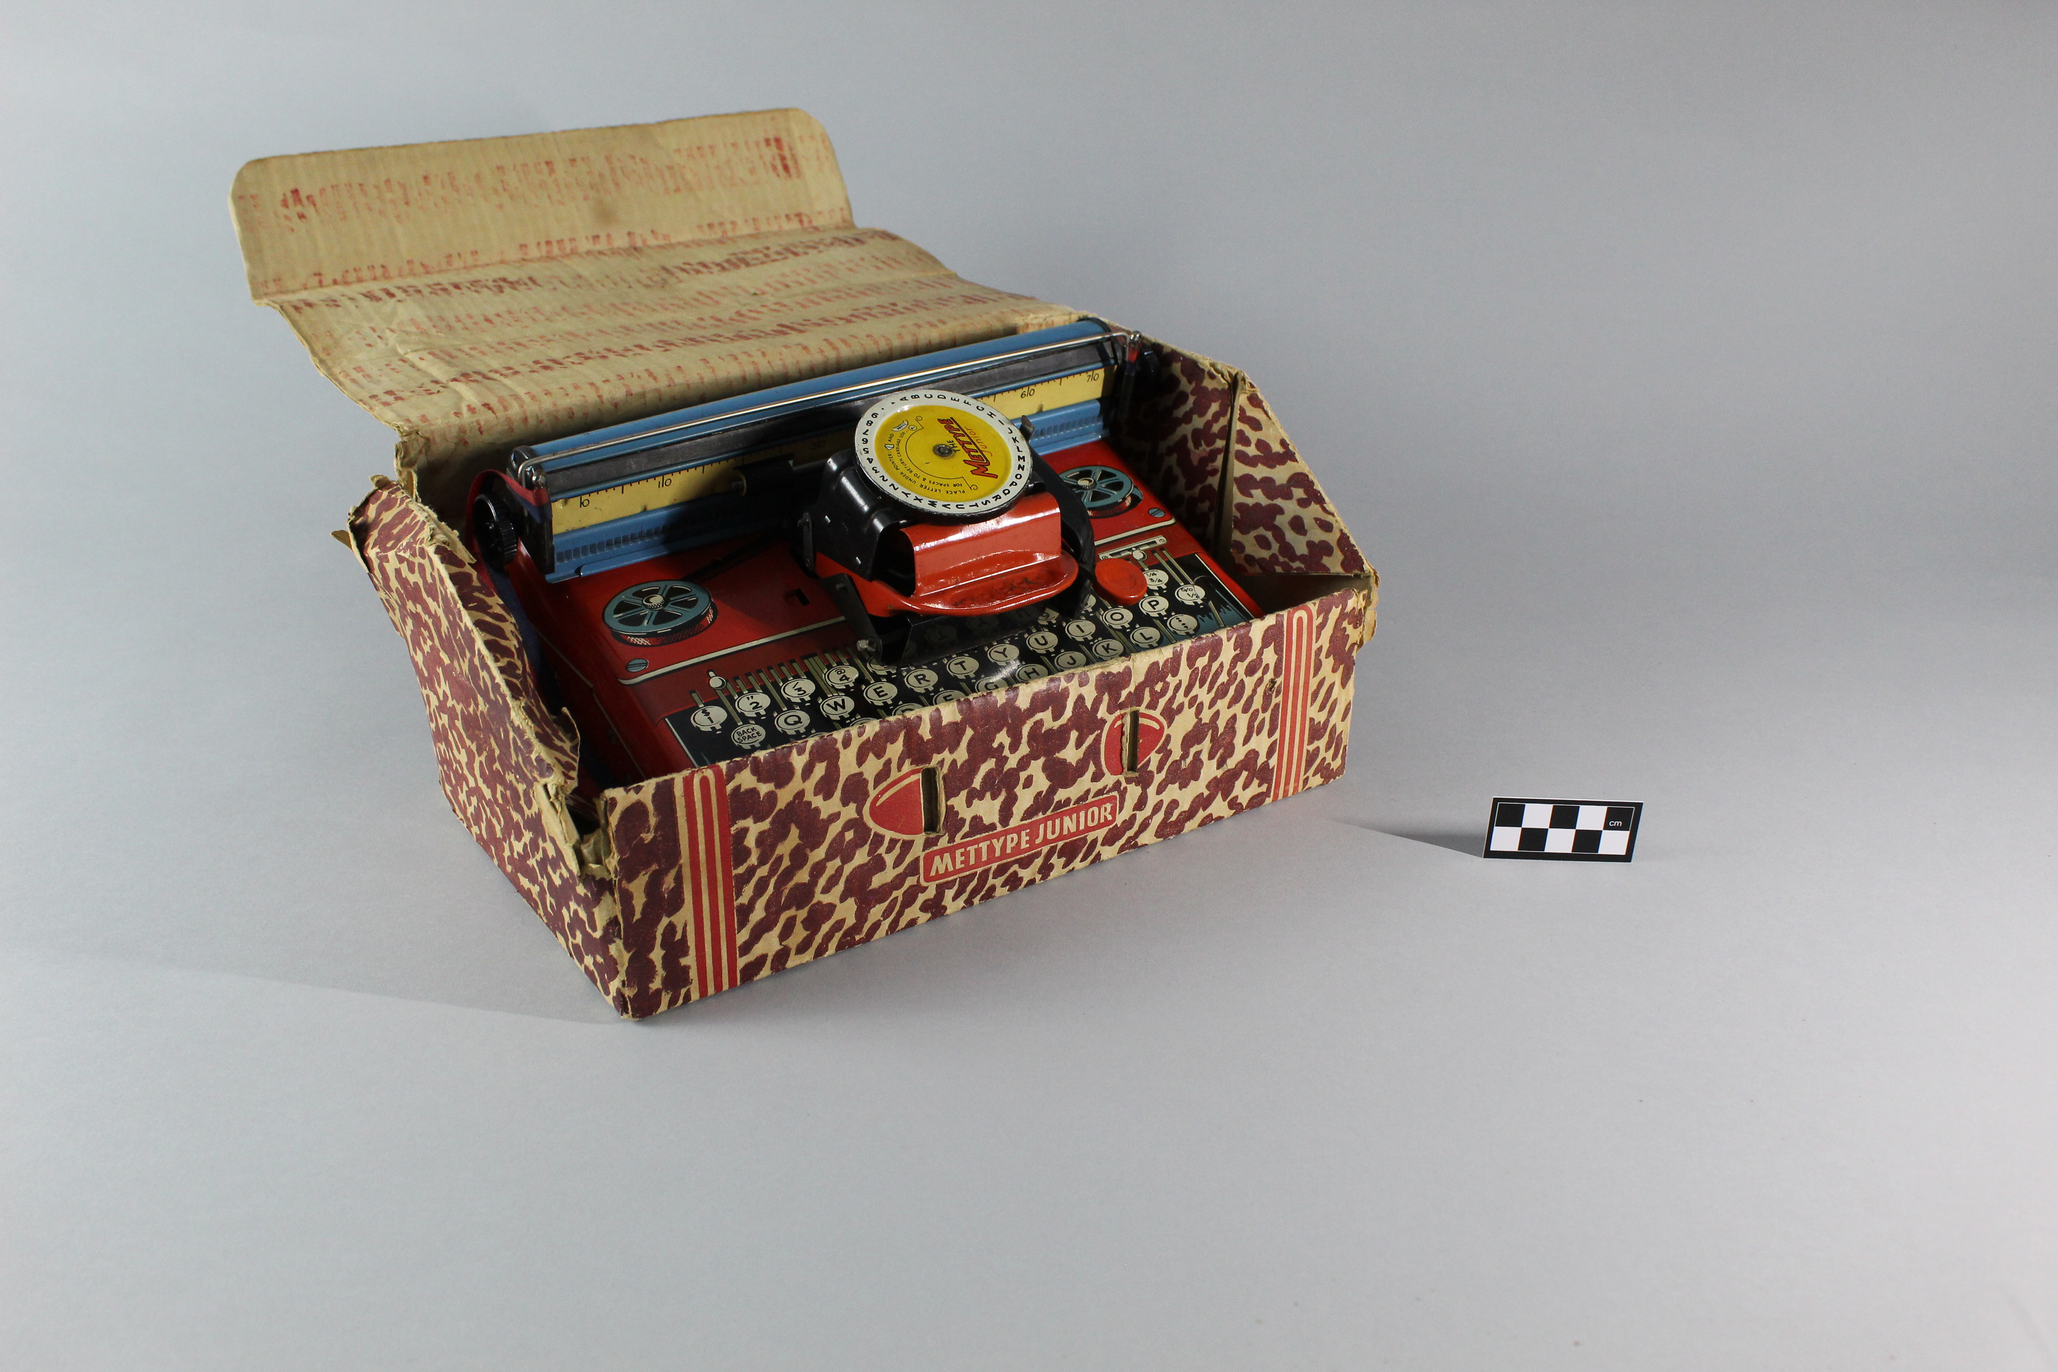
Notes:
Object: A lithographed tinplate Mettype Junior Typewriter, the main body is red, overprinted with the design of a QWERTY keyboard and ribbon spools. The rear carriage is blue with black plastic knobs for inserting/rolling on paper. The typing mechanism consists of a yellow and white rotating tin disk with black text running around the outer edge. The letter to type can be selected by turning this disk and then pressing the red tin "Press" lever below, the desired letter is printed and the carriage moves along one space ready for the next letter to be selected and typed. An inked ribbon is threaded through both ends of the carriage, as the mechanism strikes the inked ribbon, the ink is transferred to the paper leaving the mark of the desired letter. A package of replacement ribbons is included with this object, the text of the package reads "6 TWO-COLOUR RIBBONS FOR METTOY TYPEWRITERS NOS.4310, 4317 AND 4318. METTOY PLAYTHINGS. ARTICLE NO. 4318. MADE IN GT. BRITAIN. To RENEW RIBBON remove old ribbon and insert new one as in diagram using tin knife blade or similar to push the end of the ribbon first through slot 'A', then round the end and down through slow 'B'. 9" Attach both ends then adjust until the ribbon fits as diagram." Made by Mettoy Company Limited, in the 1950's.
Material: metal, cardboard, plastic
What is Lithography? Lithography is a printing process that takes advantage of hydo-phobic (water repelling) and hydrophillic (water attracting) processes. Originally a limestone block would have an image drawn onto the surface using a hydo-phobic substance, and the blank or negative areas would be treated with a hydro-phillic substance. The surface of the stone would then be covered with water which would be repelled from the areas to be printed, but stick to the hydro-phillic treated areas. An oil based ink would then be used on the surface, as oil is hydro-phobic it is repelled from the watery areas but sticks to the original drawing. A sheet of paper could then be pressed to the block, transfering/printing the image to it. In the late 19th Century a method for printing directly to thin metal sheets was invented, called Offset Lithography. Until now tin toys would have been hand painted or left bare, with the new technique thin tin plated steel sheets would have designs printed before being formed into the required shapes. With the invention of Offset Lithography, colourful tinplate toys could now be produced on an industrial scale. Tinplate toys would remain very popular until the 1960's when cheaper plastic toys would take over.
With lithography only one colour can be printed at a time, and so the process is repeated many times with different printing plates for each colour until the design is complete. How many colours can you pick out on the Mettype Junior? Which colours would have been printed first? Each new colour would be printed over the top of the previous.

Slide 6
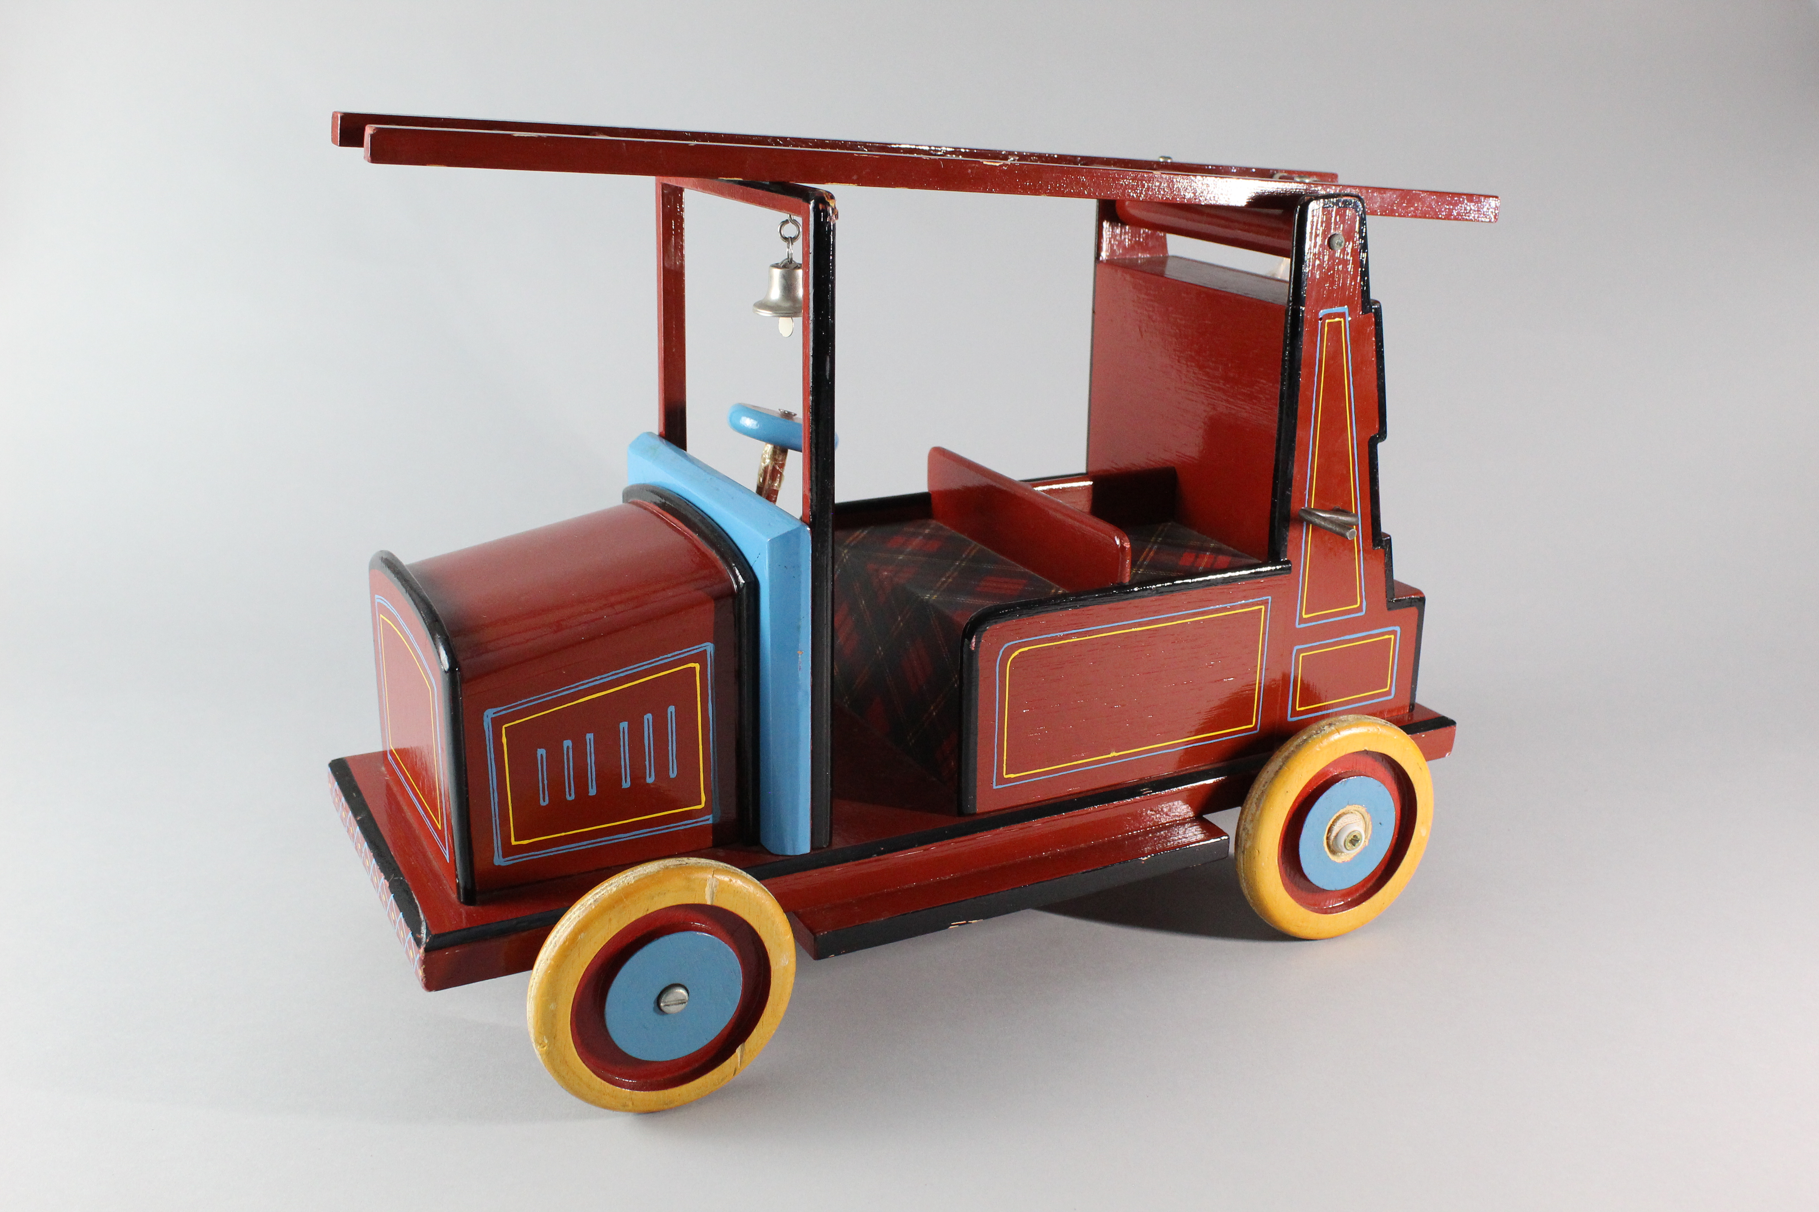
Notes:
Object: Wooden model fire engine, painted red, with black, green and silver details. The main construction is of wood, with metal fastenings and details, the ladder can be raised and lowered using a metal winch wound with cotton string. Unknown manufacturer.
Material: wood, metal, cotton
This is the second of our mystery model fire engines. What are the similarities and differences between the two models? Could they have been made by the same person?

Slide 7
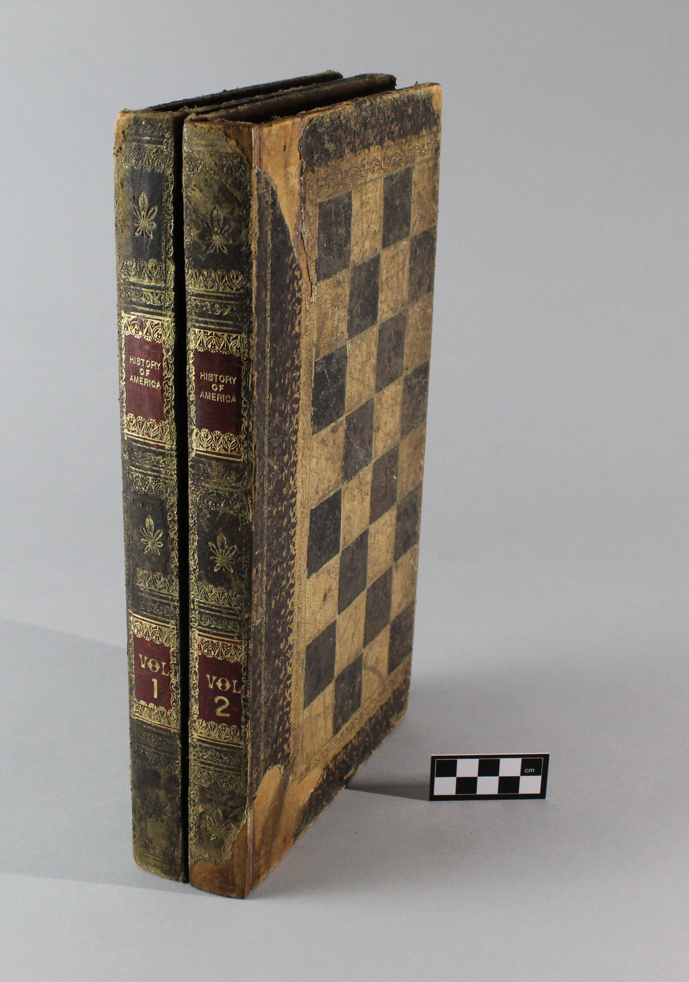
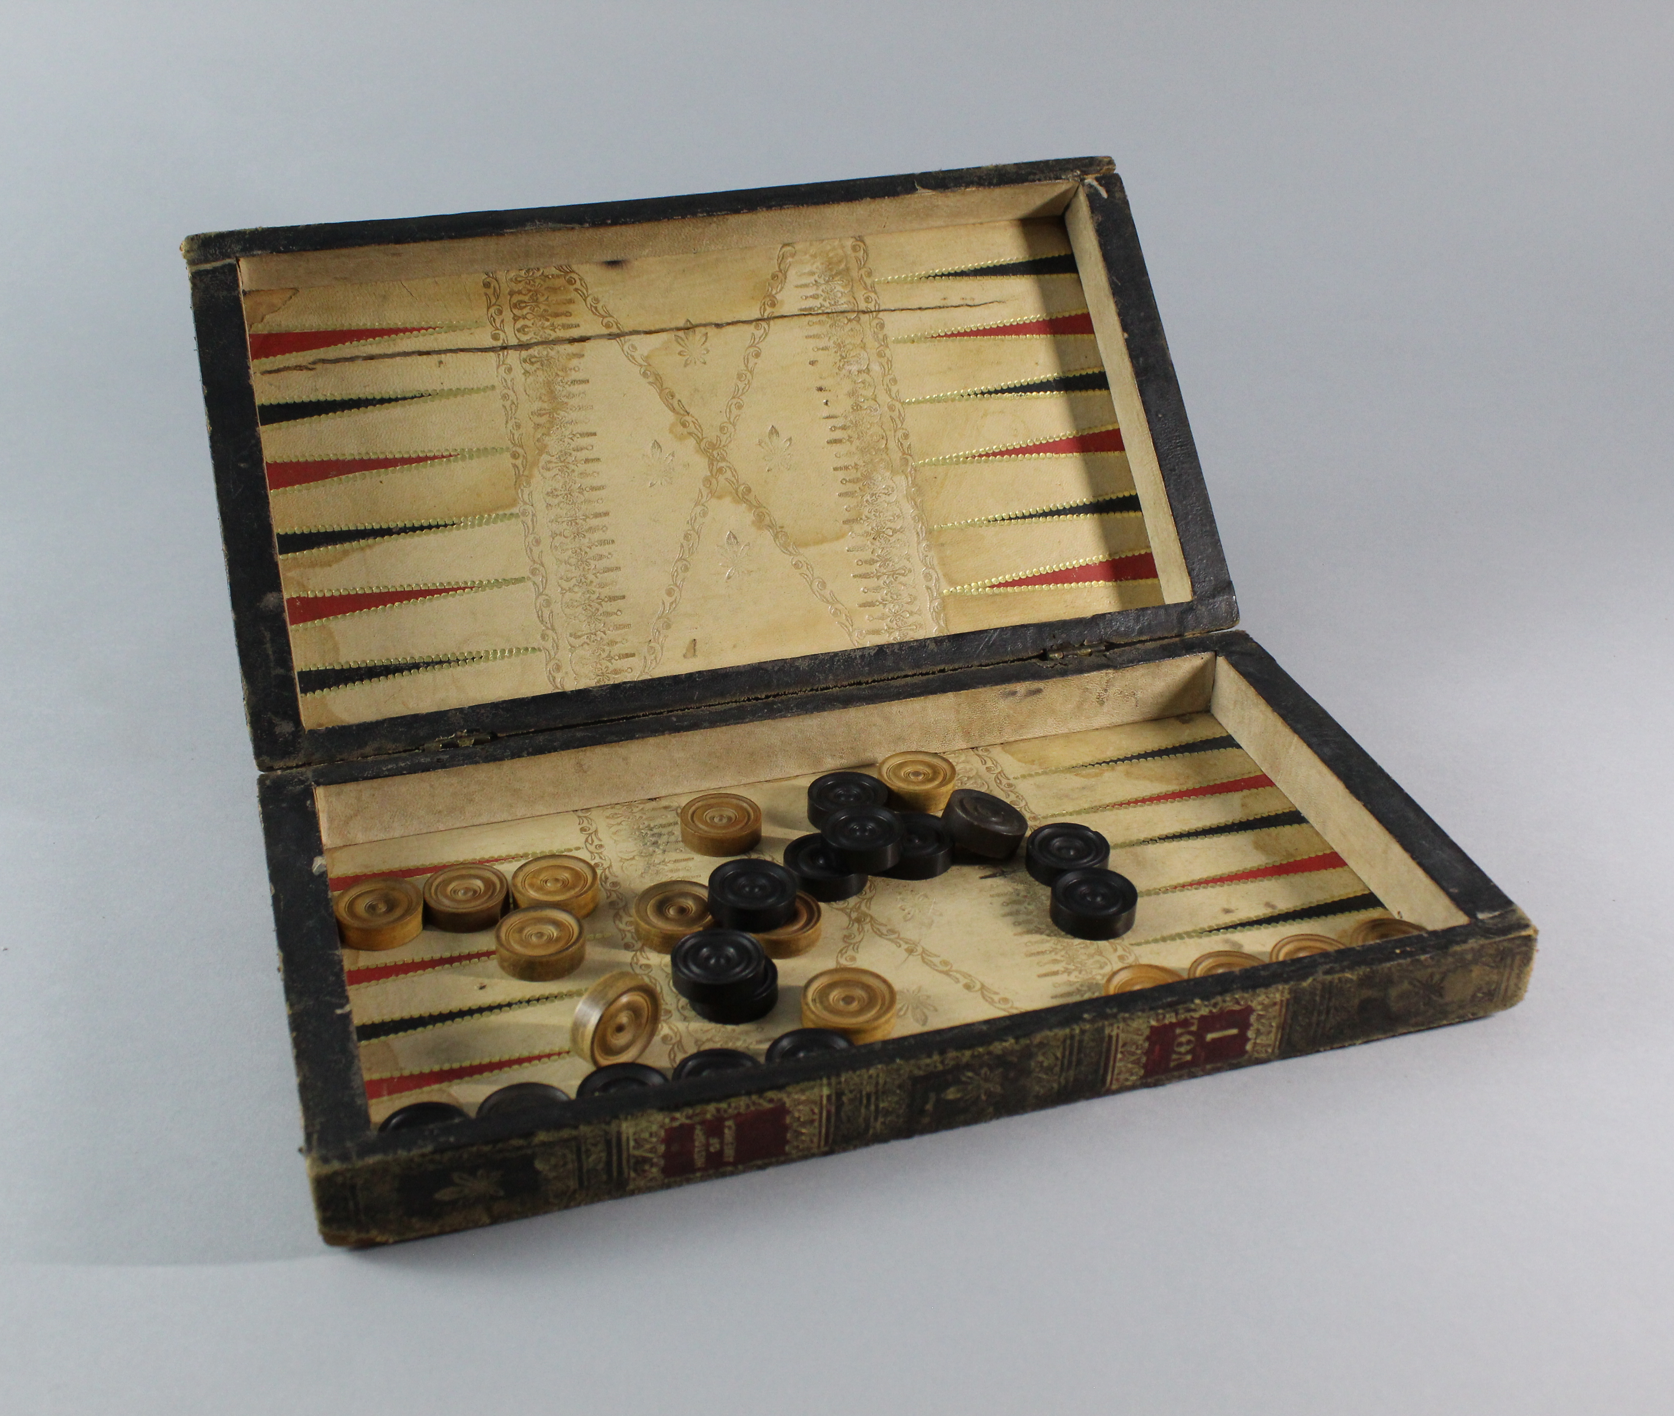
Notes:
Object: Leather bound faux book, backgammon and draughts game board, History of America Vol 1 & 2 version.
Material: wood, leather, fabric
Before showing the game boards inside, can the class guess what it is? Why would you want to hide a game like this?
When the “Books” board is opened, it reveals the game pieces and a playing field for the game of Backgammon.
This game board is cleverly disguised as a set of books. It could be placed on your book shelf or added to a pile to masquerade as a set of books. This version pretends to be “History of America volumes 1 and 2”, other pretend book sets were made “History of England”, “History of Russia” and “Parlour Games” are a few examples. Game boards like this one were produced in the Mid to Late 19th Century and early 20th Century.
The first record of Backgammon comes from England in the 17th Century (1601CE-1700CE), the word may come from the Middle English “Baec Gamen” meaning “Back Game”. Backgammon is part of a family of games known as “Tables Games” or “Race Games”, which have a history that is almost 5000 years old.
Backgammon is played with counters known as “Tablemen” and the object of the game is the move all fifteen of your pieces around the board and to be the first to remove all of your pieces. Each player rolls two die to determine how far or they can move their pieces each per turn.

Slide 8
Notes:
Object: Leather bound faux book, backgammon and draughts game board, History of America Vol 1 & Vol 2 version.
Material: wood, leather, fabric
Did you notice that the outside of the box is also a game board? What games can be played on a chequered board like this?
Chess and Draughts are played on a board like this, are they the only ones? Can these games trace their histories as far back as backgammon?

Slide 9
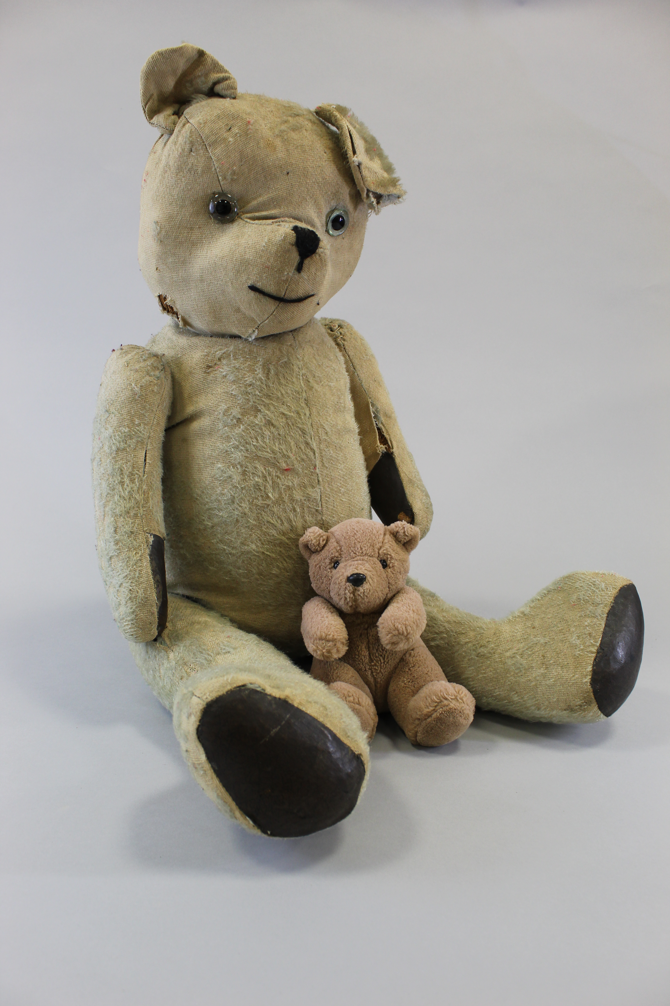
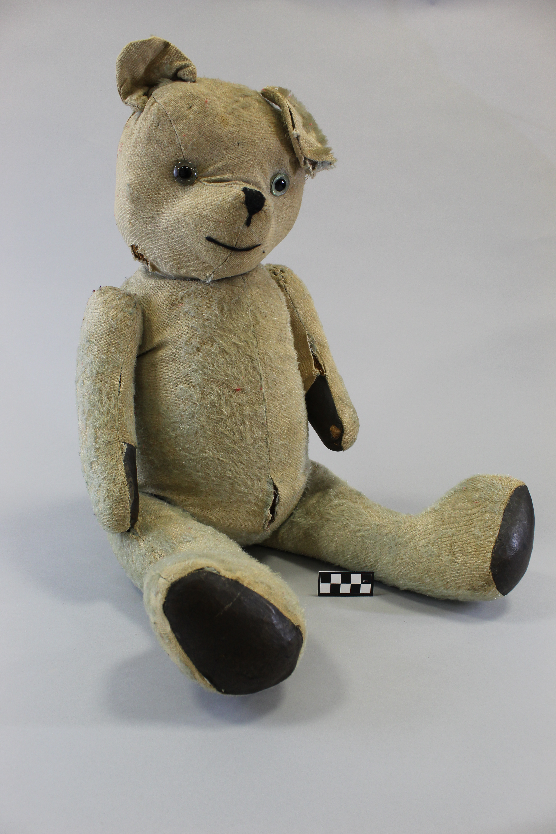
Notes:
Object: "Fred" Large excelsior stuffed Teddy Bear, light blue or golden heavily faded fur, stitched snout, black and clear glass eyes, jointed limbs and brown pads.
Material: mohair, cotton, wood, glass
Museum staff couldn't 'bear' the thought of Fred being stored alone, so we gave him a box buddy. Click again to see Freds storage partner.
Excelsior (fine wood shavings also known as "wood wool")
We speculate that this bear was manufactured in France during the early 20th Century by the Fadap company, the upturned nose is a defining feature of Fadap bears. However due to the bears age and repairs that have been made, it is difficult to identify and may have been produced around the same time in England, which had many popular manufacturers like Deans Book Rag, Chiltern, Merrythought, Chad Valley and Farnell.
What's in a name? The origin of the name "Teddy Bear" can be traced back to the early 1900's and the 26th President of the United States of America, Theodore Roosevelt. In 1902 Roosevelt a well known trophy hunter, joined a group on a bear hunting trip in Mississippi. The President was unsuccessful at finding a bear himself and so a bear was cornered and tied to a tree for him to shoot by members of the group. Roosevelt felt that this was unsportsmanlike and refused to shoot the restrained bear, the story soon spread and a satirical cartoon of the event appeared in the Washington Post Newspaper. Morris Michtom a Brooklyn based shop owner and his wife Rose created a stuffed bear naming it "Teddy's Bear", dedicating it to the president and the bear he refused to shoot.
Around the same time as Michtom was producing stuffed bears in the United States of America, the German based company Steiff also began the production of stuffed bears and other animals based on drawings of zoo animals made by Richard Steiff. Steiff benefited from the Teddy craze selling their stuffed bears to American Toy Sellers and from 1906 they officially used the named these products "Teddy Bears". Steiff are now one of the worlds most famous stuffed toy manufacturers and still make teddy bears to this day.

Slide 10
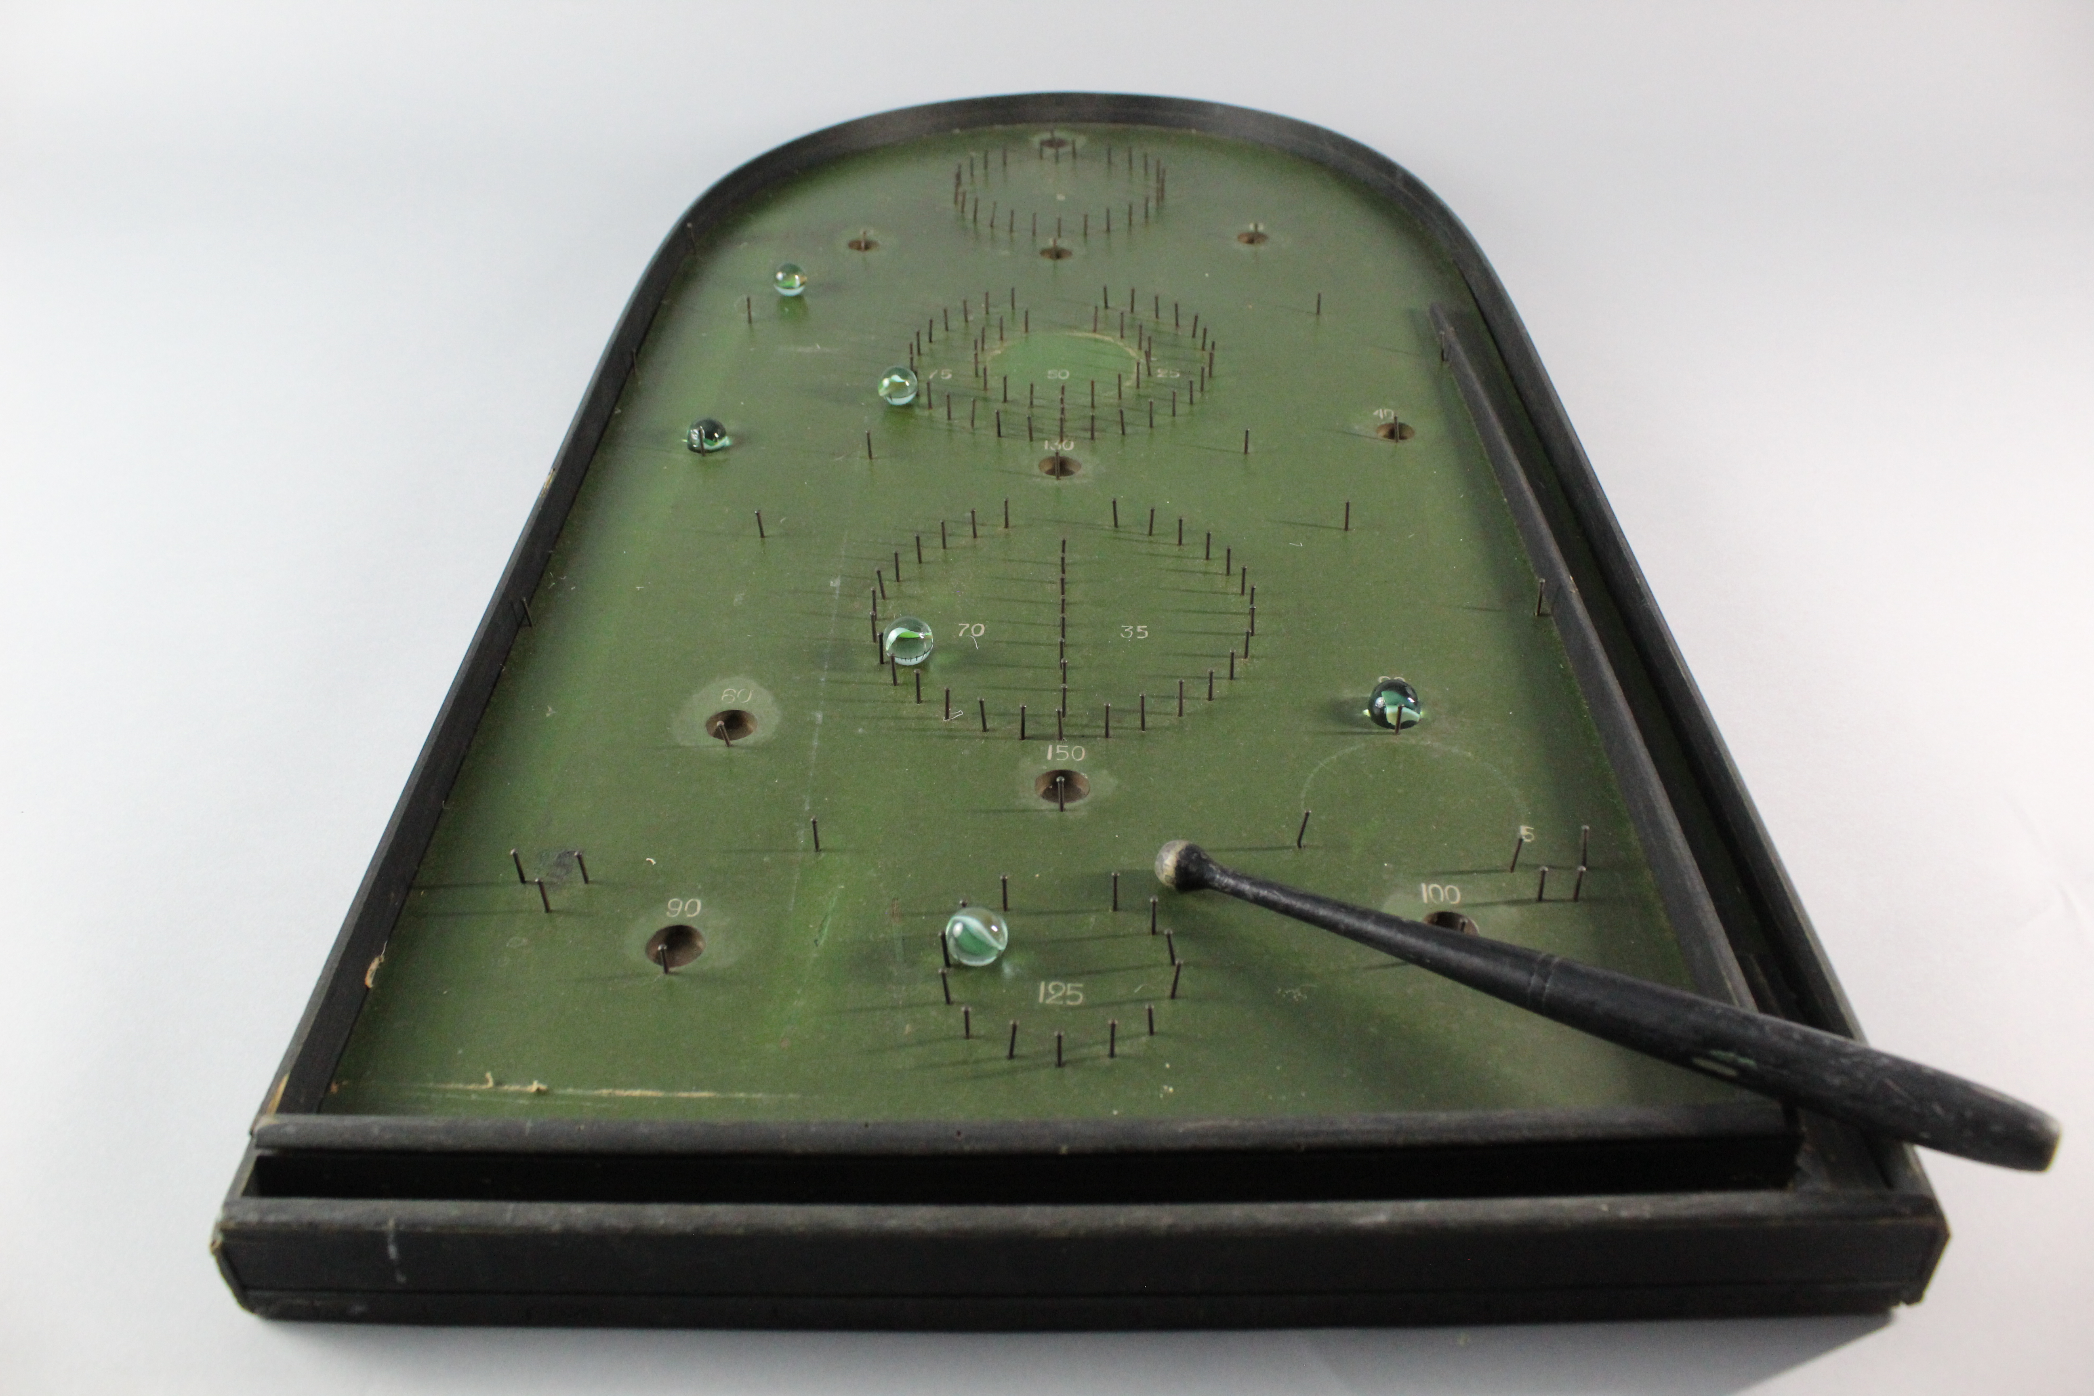
Notes:
Object: Parlour/Pin Bagatelle Board.
Accession Number: PETMG:2004.016
Material: wood, metal, felt, glass
Bagatelle is a game that was developed from around the 15th Century (1401CE-1500CE) onwards, the game developed from other cue games like Billiards which were designed to be played as alternatives to outside lawn games (Ground Billiards) during poor weather.
Parlour or Pin Bagatelle is a smaller version of the game Bagatelle, designed to be played on a table top and to be portable. The object of the game is to hit balls along the right hand shoot using the cue. The board has a number of holes and scoring zones made with metal pins, other metal pins are set into the board as obstacles to known the balls away or trap them. Each hole and scoring zone has a number which you score if the ball lands within them, any balls that reach the bottom score 0.
Parlour/Pin Bagatelle would continue to develop into the modern game of Pin Ball.
The Name Bagatelle is thought to come from Château de Bagatelle, which was the home of the French Count of Artois, Charles-Philippe and future king Charles X of France. In 1777 the current king of France Louis XVI, was invited by Charles to a party at his home where the king played a version of the game. This game would come to be known as Bagatelle, after the house in which is was played and quickly become popular throughout France and beyond.

Slide 11
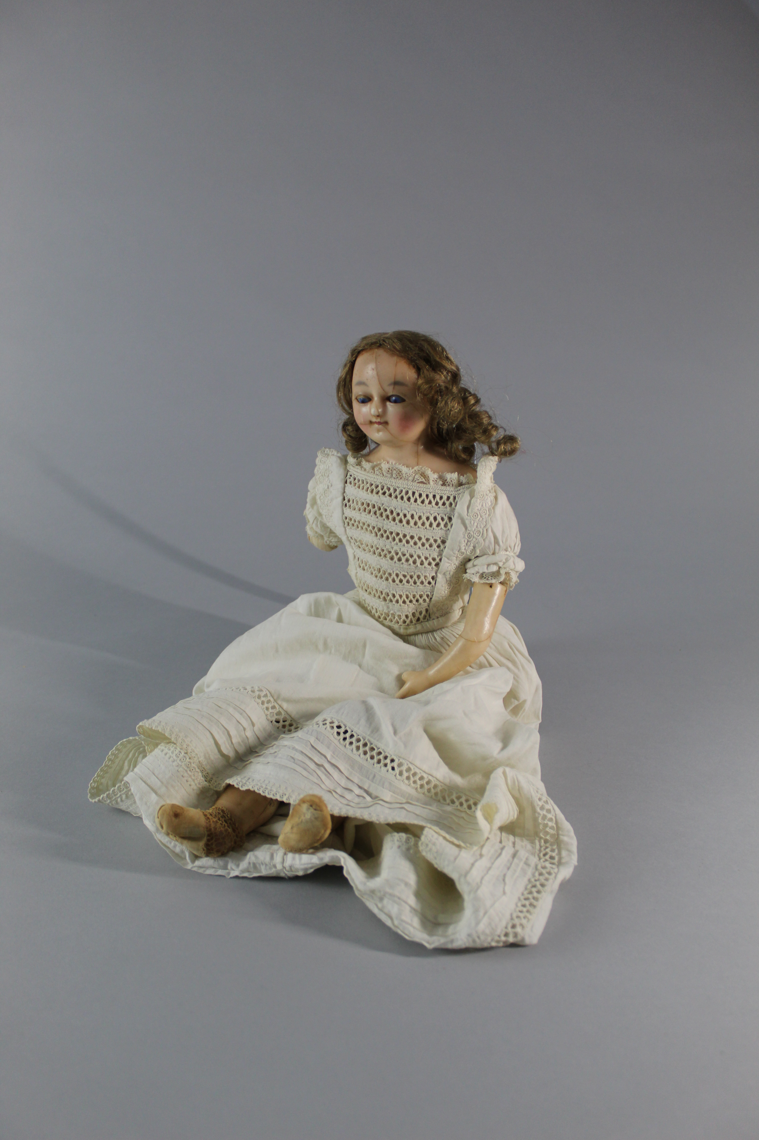
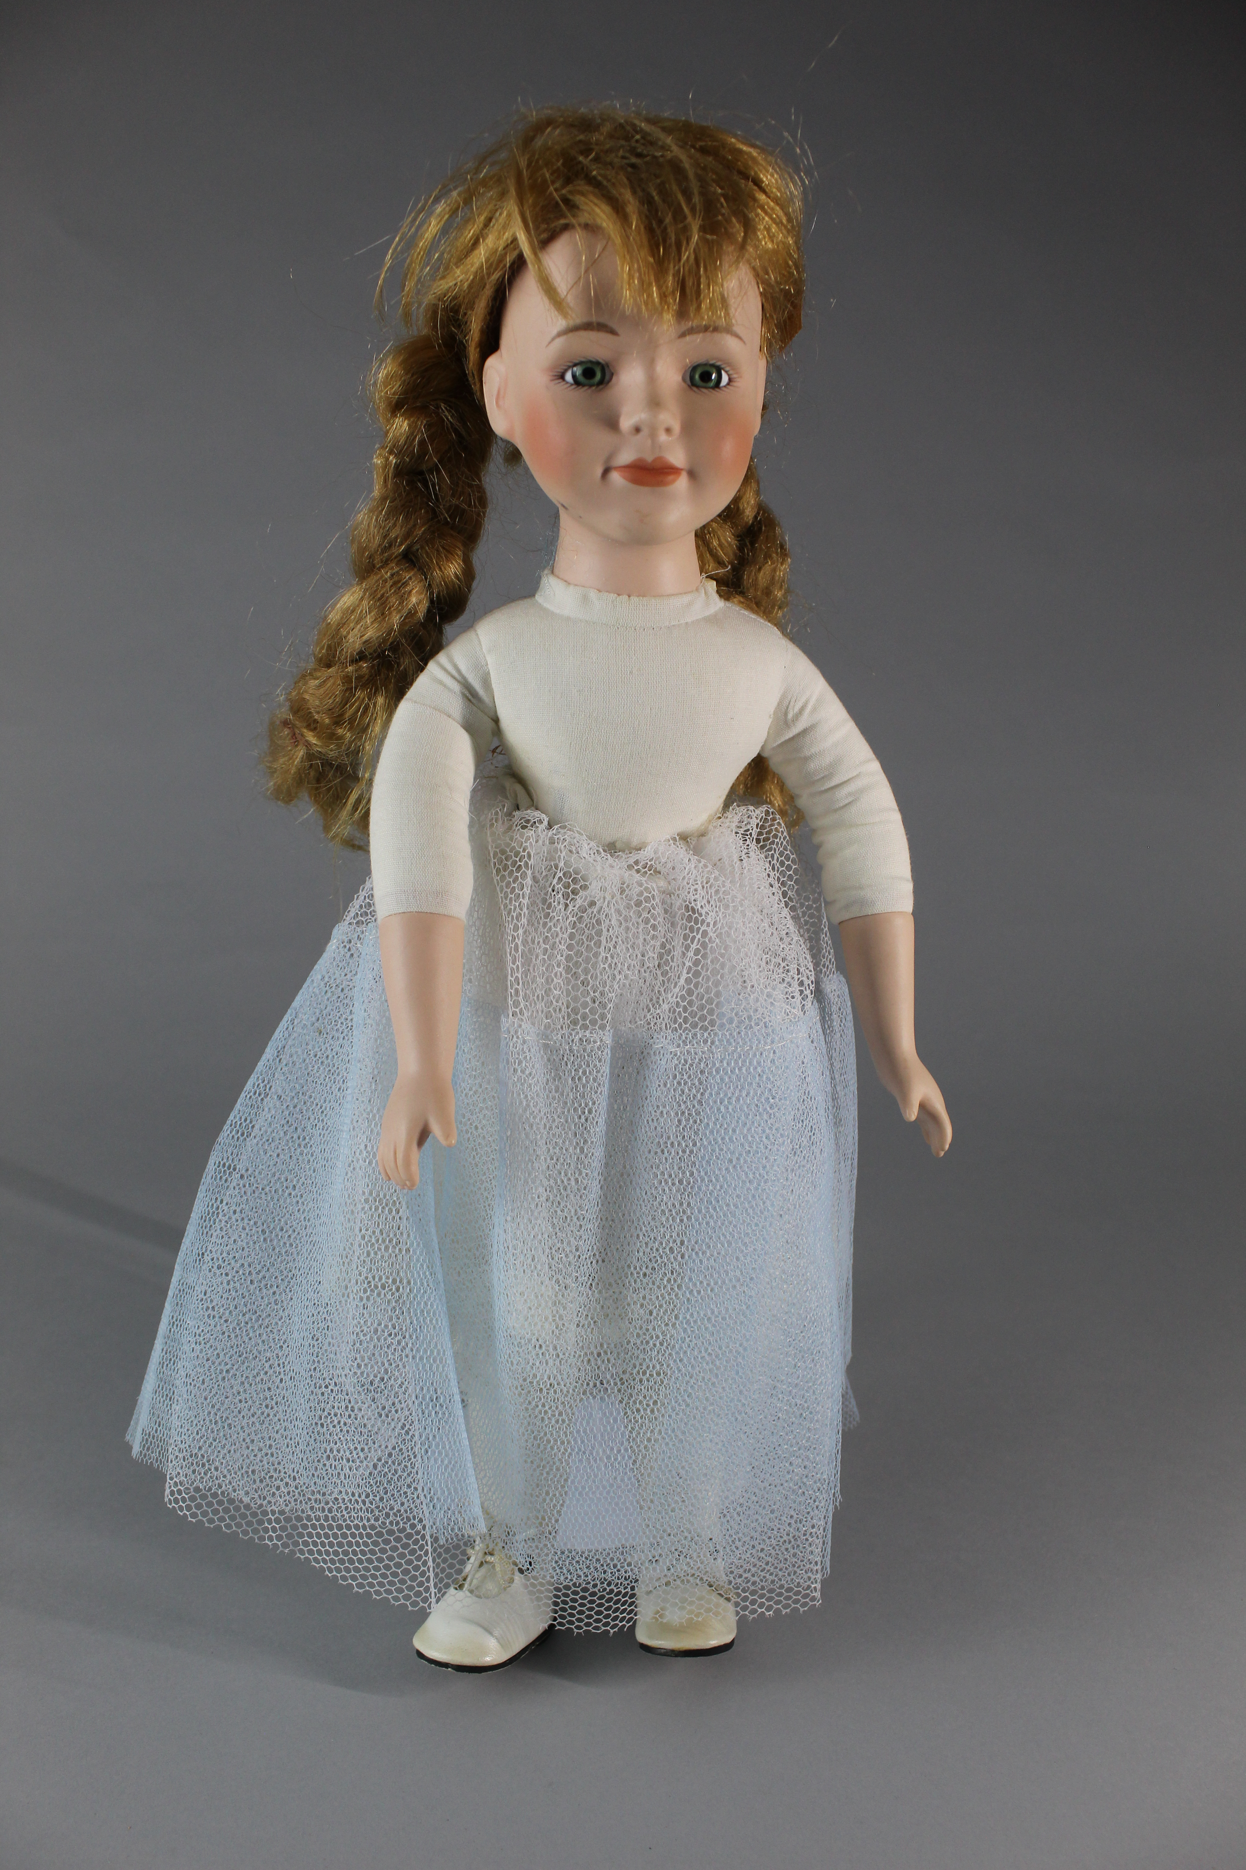
Notes:
Object: Unkown ?
Material: Unkown ?
Have a look at these two dolls, through observation what differences and similarities can you see? Using those observations can you make informed guesses about the materials they are made from or which is older and why?

Slide 12
Suggested Activities
What is in a name? Why are games called what they are, can you think up any new names for games like Bagatelle or Backgammon. Play games like "Kerplunk" as a group, can you work out that the name uses onomatopoeia? Or that the names describe the actions of the game such as "Mouse Trap"?
Reinvent classic games - Become game re-designers, can you take old games like draughts and design a new set of rules. Think about how games are created and can evolve overtime. Are there any games you play already with your own set of rules?
Compare with modern toys - Create your own collage of toys, how do they differ and how are they similar to the examples you have seen in this resource?
What games could you play with these toys? Imagine you have been given a box of toys like these, what games would you play? would the way you play with them change because of their age?
The difference material makes - Take one of our toys or ones you have yourselves and think about the materials they are made from and why those materials were chosen. Now imagine you could turn them into any other material at all and the difference that change would make. If we took a plastic set of Kerplunk and turned it into wood, would it still "Ker-Plunk"? Or perhaps we made a Teddy Bear out of Lime Jelly, would you play with it in the same way? How has the sensory experience, the touch, smell, sounds and taste of the toy changed?

